Slide 1
Using Your Smartphone for High Adventure Photography
Terry McKibben
Assistant Scoutmaster Troop 344/9344
Pemberville, OH
troop344leaders@gmail.com

Slide 2
01
How to Choose the Right Smartphone for You
There are a few things to look out for when in search of the ideal smartphone for adventure photography.
02
Use a Third-Party Camera App
If your default camera app lacks any of the basic features, download a third-party camera app. These apps can unlock a ton of functionality.
CONTENTS
03
Smartphone Camera Modes and Settings Explained
Smartphones come loaded with a default camera app for taking photos.
04
Use the Rule of Thirds
The most basic compositional techniques is the rule of thirds.
05
Make Use of Leading Lines
Carefully compose lines in your pictures.

Slide 3
06
Use the Foreground, Middle Ground and Background
Include interesting elements in the foreground, middle ground and/or background.
07
Change Your Perspective
Change your viewpoint by taking photos from a bird’s-eye view or worm’s-eye view.
CONTENTS
08
Play with Distance
To showcase a spectacular background.
09
Shoot when the Light is Right
Your best, most effortless captures will happen in the “golden hours” just after dawn and just before dusk.
10
Add Motion
Try playing around with time-lapse, slo-mo and video.

Slide 4
11
Add Camera Accessories
There are add-ons for phone cameras that can help
you.
12
Take a Portable Battery Pack
Don’t run out of power.
CONTENTS
13
Edit Your Photos
Photo editing can go a long way toward improving your photos.

Slide 5
01
How to Choose the Right Smartphone for You
There are a few things to look out for when in search of the ideal smartphone for adventure photography.
Ability to Shoot in RAW
Battery Life
Phone Memory and Storage
Megapixels
Lens Aperture
Flagship Models

Slide 6
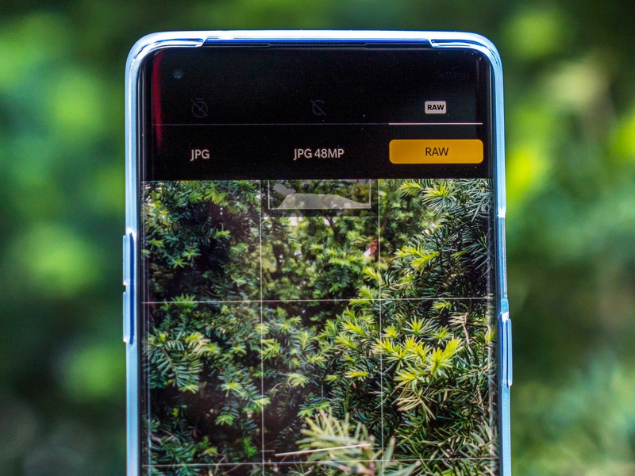
Ability to Shoot in RAW
There are a few things to look out for when in search of the ideal smartphone for you.
If you really want to be able to do something with your photos, such as editing and printing them later, then being able to shoot in RAW is absolutely essential.
RAW files contain more information than JPEG files.
However, not all smartphones are capable of shooting in RAW, so be sure to check the specs when you’re on the hunt for a new mobile phone.

Slide 7
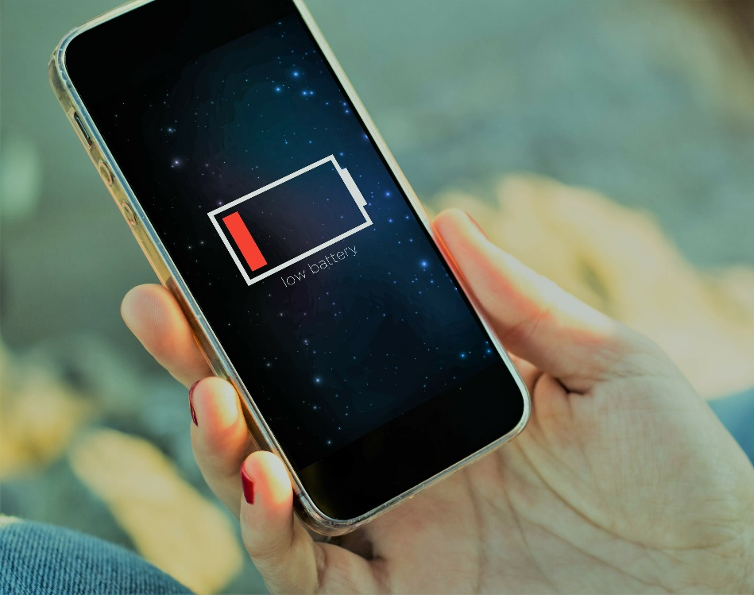
Battery Life
Another thing to consider is the battery life.
Ideally, you’ll want a smartphone that works at 4.000 mAh or even better.
The reason for this is that when you're shooting with a smartphone, especially during the day, you’ll want to have the brightness of your screen turned up to the maximum to be able to see what you’re shooting.
Turning up the brightness can drain your battery very quickly.

Slide 8
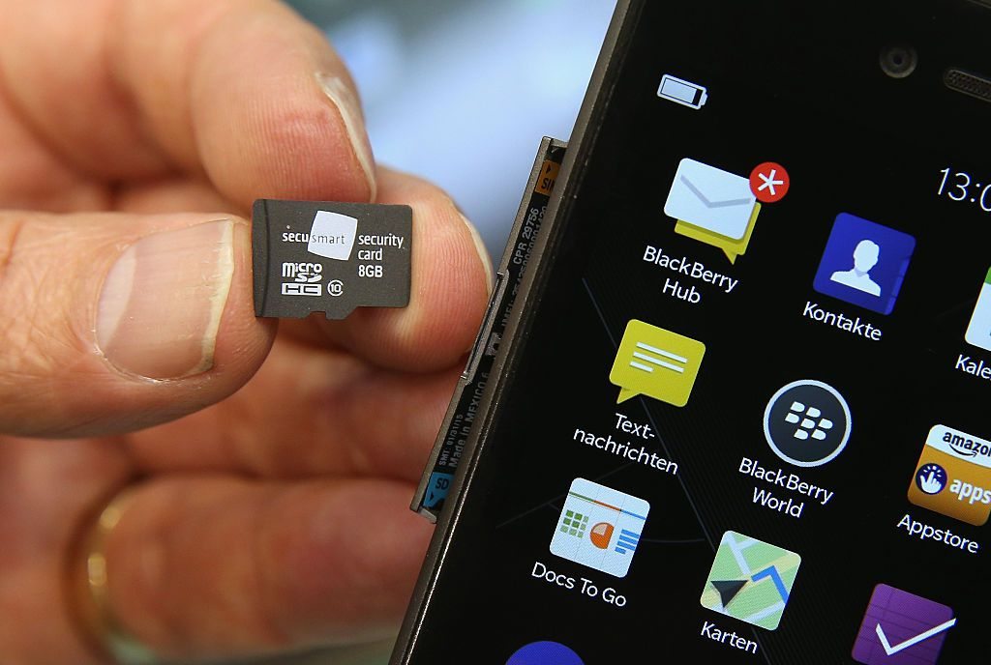
Phone Memory and Storage
There are huge differences in price between models depending on the storage and you might find yourself paying significantly less for a phone with 64GB of storage as opposed to one with 256GB.
There’s no need to splash out on the most expensive option though, as 128GB should be enough to store photos from a couple of trips.
My advice is to download your photos from your smartphone to another storage device such as a hard drive after every shoot, much as you would with a normal memory card in a DSLR camera.
This will ensure that you’ll have enough memory on your phone for new photos on your next trip.

Slide 9
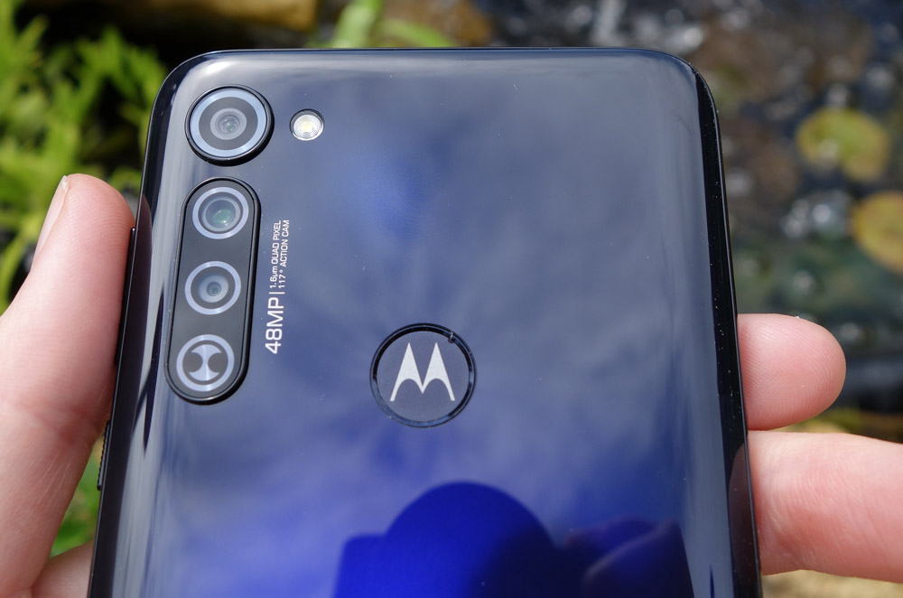
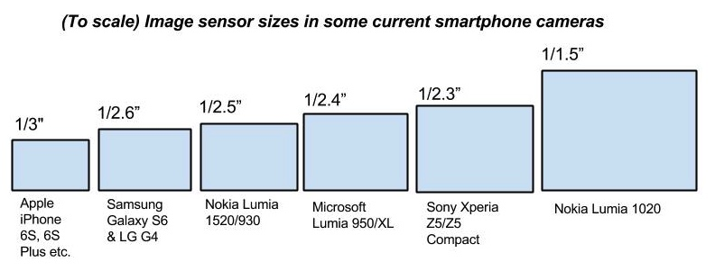
Megapixels
While the megapixel count on a smartphone is important in landscape photography, a high megapixel number doesn’t automatically mean that you’ll be able to take amazing pictures.
The key to taking great photos using your smartphone is actually in the size of the camera sensor – the bigger the sensor, the better your photos will be in terms of quality.

Slide 10
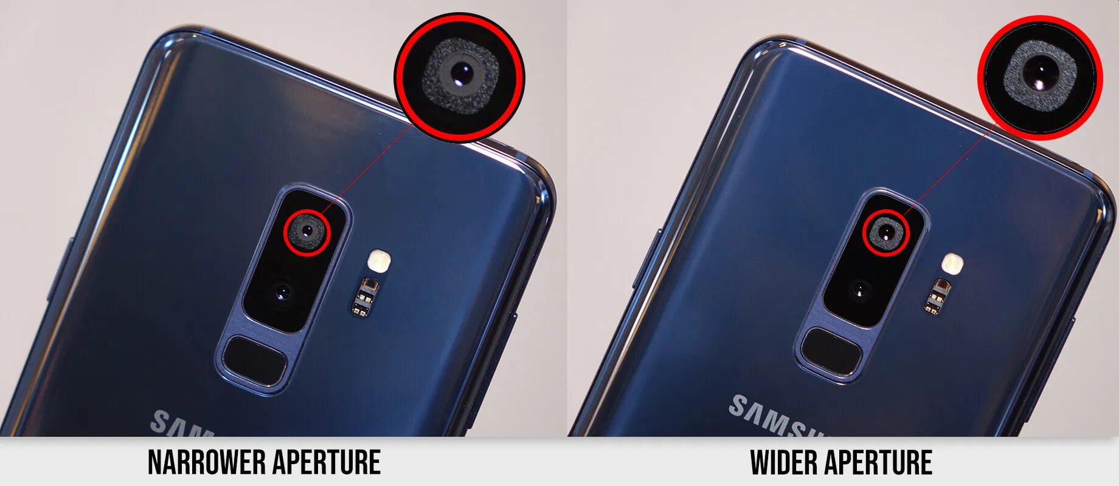
Lens Aperture
Most in-built mobile phone cameras come with a wider aperture (lower f-stop).
The best aperture to have for a smartphone camera is something between f/1.6 or f/1.8, as these lenses will be able to let in more light, which can help you to produce better shots in dark lighting conditions.

Slide 11
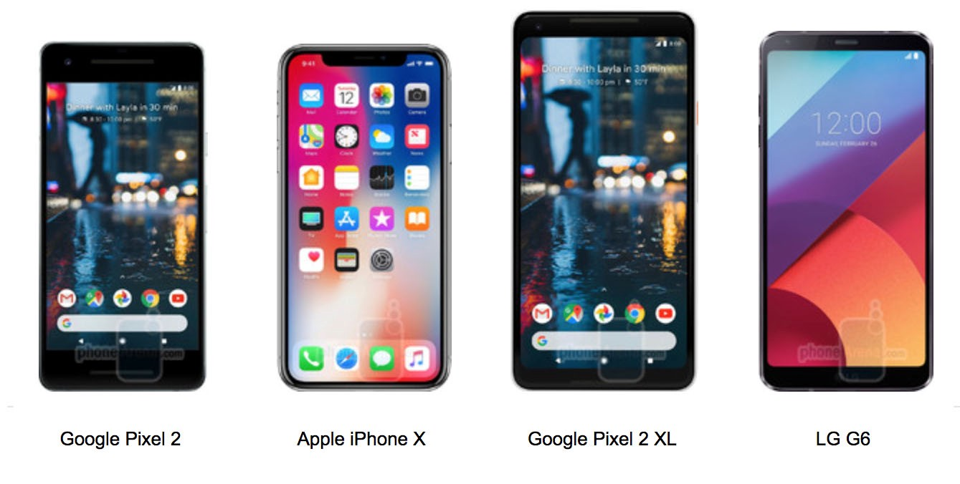
Flagship Models
Once a year, smartphone companies introduce their flagship models onto the market.
These phones usually possess the best specifications for that company’s mobile phone technology at that moment in time.
They’ll often contain the company’s best camera, their best battery, best microchips and more, which can be useful if you want to be at the forefront of developments.

Slide 12
02
Use a 3rd Party Camera App
If your default camera app lacks any of the basic features, download a third-party camera app. These apps can unlock a ton of functionality.
SnapSeed(Free)
VSCO Cam (Free)
ProCamera (Free)
Afterlight (Free)
Camera+ ($2.99)

Slide 13
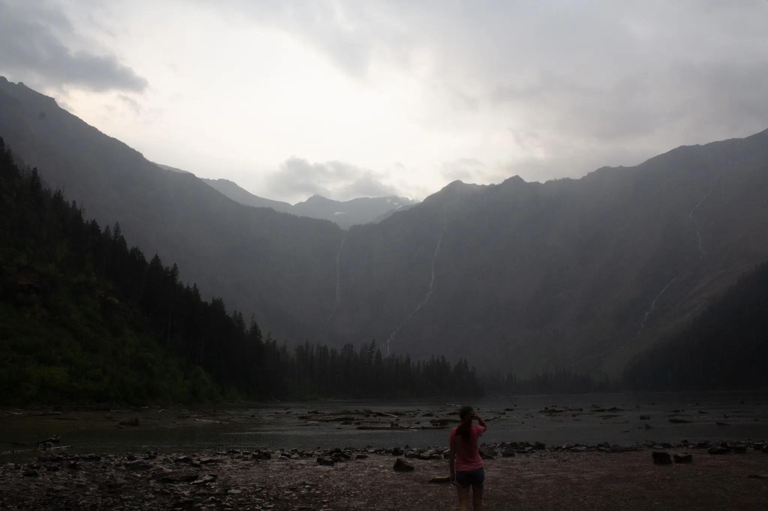
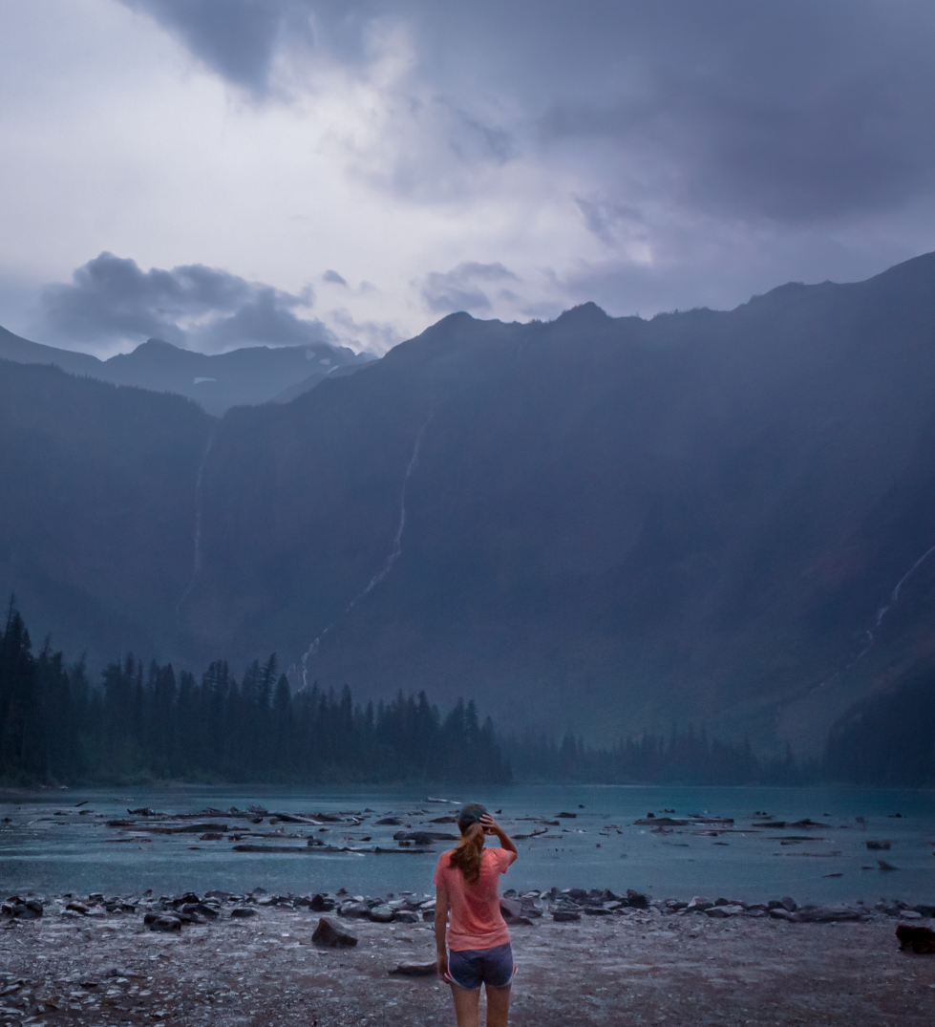
Perfect Your Shots with Free/Low-Cost Photo Editing Apps
Snapseed, VSCO Cam, ProCamera, and Afterlight are great photo editing apps.
If you’re willing to spend a few bucks, you might try Camera+.
Subtlety is key and your goal should be to create the impression that you haven’t adjusted anything at all.
Before and after editing for crop and color

Slide 14
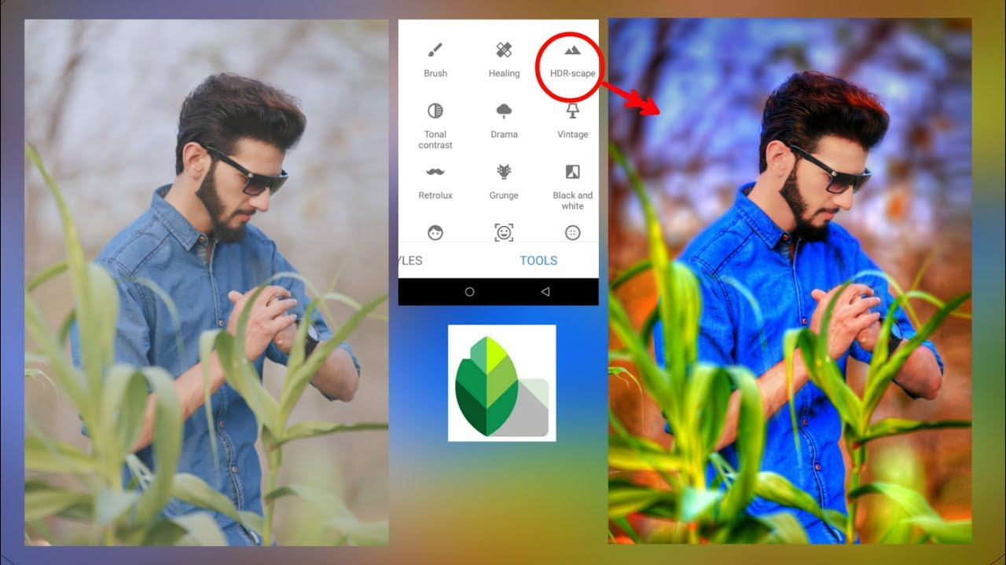
Snapseed (Free)
Snapseed is a free, Google-owned photography editing software.
This app brings the power of a computer editor to your phone with simple-to-use preset filters.
Beyond that, for professional or aspiring photographers, there are many tools to edit images in ways that otherwise only exist in expensive photo editing software.

Slide 15
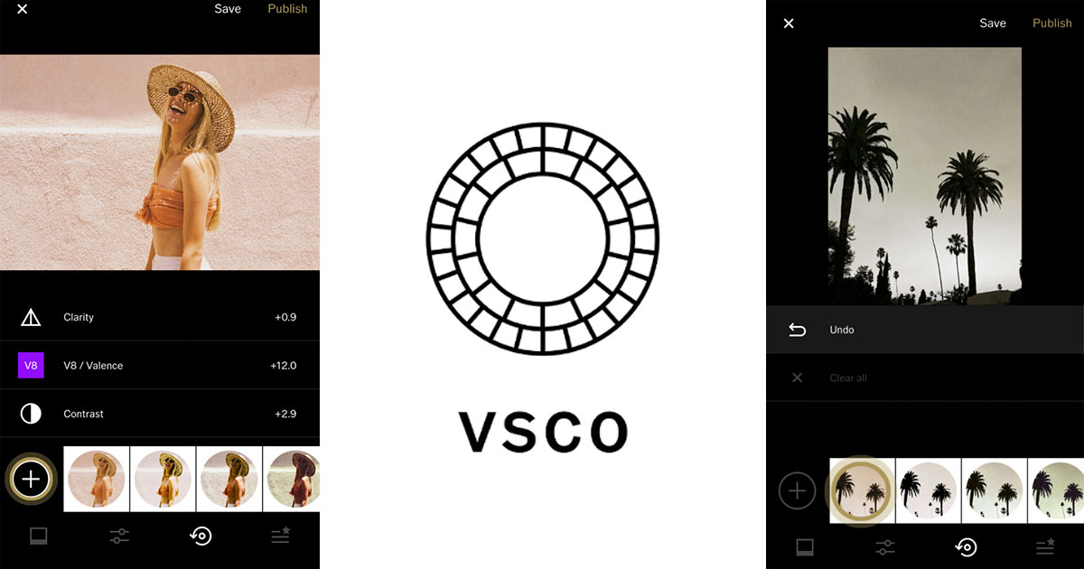
VSCO Cam (Free)
VSCO Cam is a feature-packed camera app that allows you to take high quality pictures and edit photos.
The range of photo editing tools in VSCO Cam is as good as any you'll see in a free photo app.
There are settings for exposure, temperature, contrast, saturation, tint, shadows, and much more, which can all be set easily via a slider.
This app allows you to control shutter speed, ISO, white balance, exposure, and manual focus.
The settings are easy to access from the bottom of the screen and adjustments are made using a simple slider.
There's also a smart crop tool with preset aspect ratios, and a rotate tool.
VSCO Cam also has great photo sharing features.

Slide 16
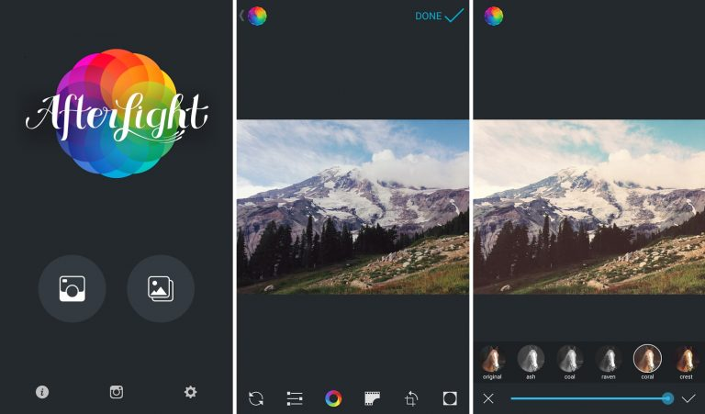
Afterlight (Free)
Afterlight is a full-featured photo editing app with plenty of creative options.
With the Afterlight app, you can enhance your photos with adjustment tools and filters.
You can create unique edits with textures, light leaks and double-exposure tools.
You can even add text, artwork and frames to your images.

Slide 17
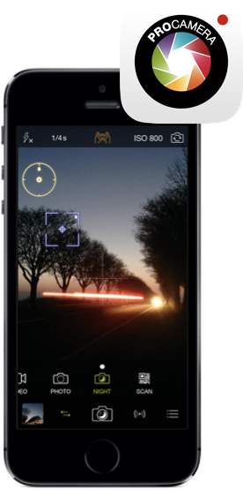
ProCamera (Free)
This free camera app can boast a full range of settings, which you can use in semi-automatic and fully manual mode.
Moreover, ProCamera also offers a stabilization function and has an intuitive interface for precise focus control and exposure adjustment.
In addition to the standard JPG format, this application also shoots in RAW format, and photos can then be slightly processed in the built-in editor.
Perhaps, one of the main advantages of ProCamera is the full-screen shooting mode.
By turning it on, you can take a picture by tapping anywhere on the screen.
If you have a closer look at the app’s settings, you will find a composition grid, a histogram, a timer and burst shooting mode.

Slide 18
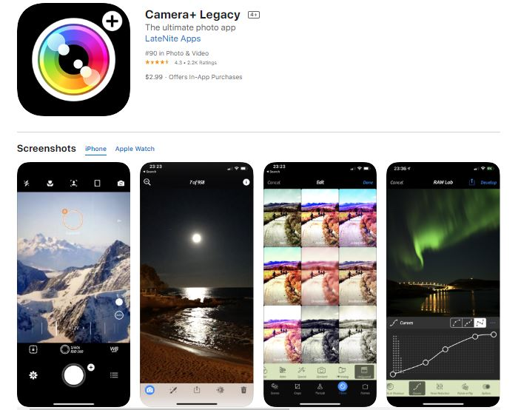
Camera+ Legacy ($2.99)
Camera+ Legacy is an app that features tools like Touch Exposure & Focus, Digital Zoom, Horizon Level, and Clarity.
It also has different shooting modes, scene modes, and effects to help users in adjusting their photos.
It has a built in image stabilizer, tone adjustment tools, red eye remover tool, white balance modifier and many other impressive features and capabilities.
You can share the edited images directly on Facebook and Twitter.

Slide 19
03
Smartphone Camera Modes and Settings Explained
Smartphones come loaded with a default camera app for taking photos.
Exposure Adjustment
Focal Point and Exposure Level Lock
Aperture Mode
HDR Mode
Timer
Flash On/Off
Add Gridlines
Shutter Speed Adjustment
ISO Adjustment
Night Mode
Portrait Mode
Monochrome Mode
Super Macro Mode
Burst Mode
Image Stabilization
File Formats
Panoramic Mode
Digital Zoom

Slide 20
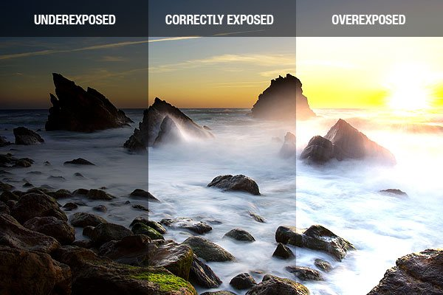
Exposure Adjustment
Many default camera apps let you adjust the exposure of an image.
Simply tap on your main subject (the area you want to be sharp).
An exposure/brightness slider will appear on the side of the screen.
Then swipe up on the slider to raise the exposure, and swipe down on the slider to lower it.

Slide 21
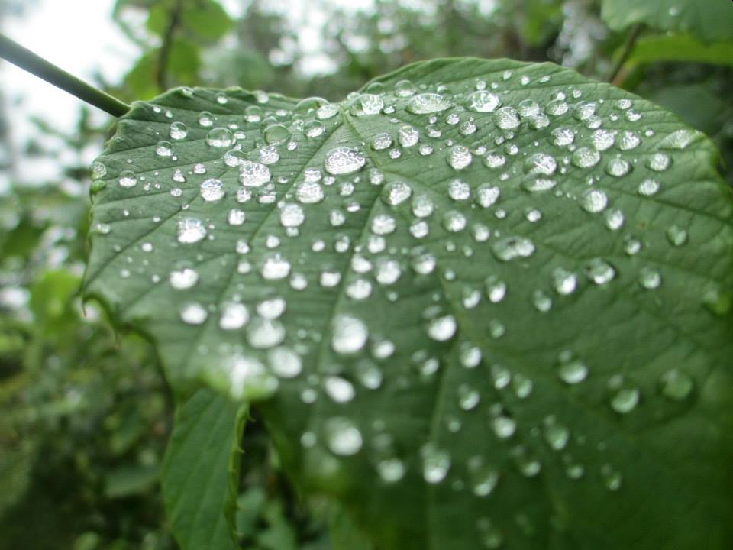
Focal Point and Exposure Level Lock
On many phones, you can press and hold your finger on a subject to lock the focal point and exposure.
This ensures that subject will be in focus and exposed just how you want it to be when you click the shutter.
Experiment with bokeh, or “artful blurring.”
Hold your finger on your viewfinder for a sec to lock a point of focus (pick something far away for a blurred foreground, extremely close for a blurred background), then shoot away for gauzy, dreamlike textures.

Slide 22
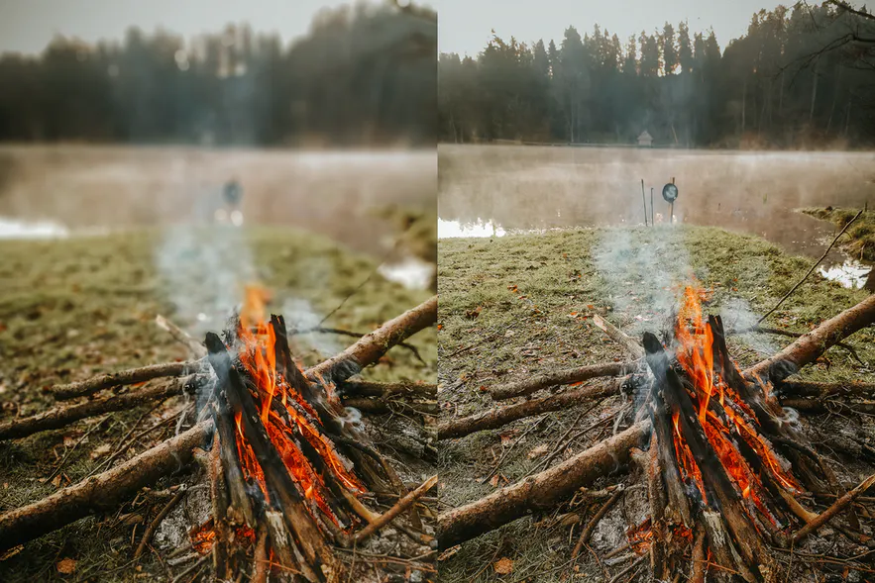
Aperture Mode
The aperture mode controls the amount of light that reaches your smartphone camera sensor.
A bigger aperture means that more light will land on the sensor as the diaphragm of the lens expands, while a smaller aperture will restrict the amount of light that is able to enter and create a narrower depth of field.
This results in a photo where the foreground may be sharp and in focus, but the background is blurry.
This effect on a smartphone camera helps to emphasize subjects that are within 6 feet of you.
Simply choose the aperture number that you want to use and the camera will blur the background.
Once you’ve taken a shot, the photo will usually show up on the screen of your phone.
An example of how the aperture mode can emphasize subjects in front of you. Left is f/0.95 and right is f/16.

Slide 23
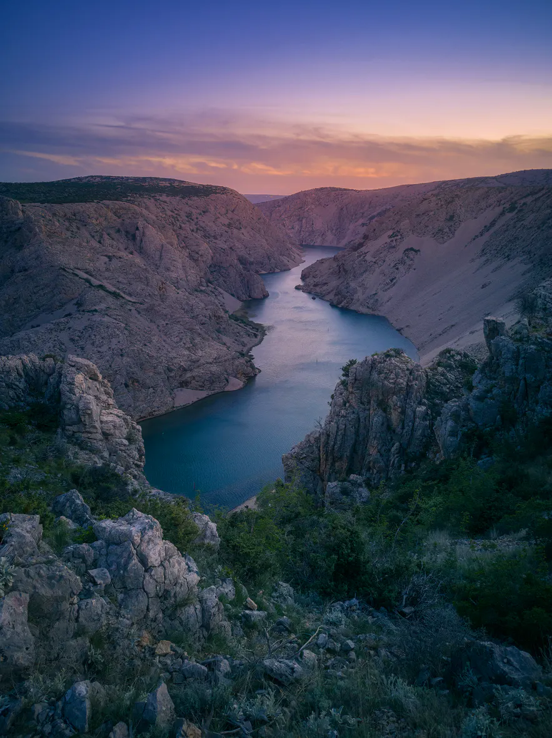
HDR Mode
When you take a photo in high dynamic range (HDR) mode, your camera actually snaps several pictures at different exposures and then combines them to create a single image.
This is a great way to capture the full range of lights and darks that are in a scene.
Using HDR can be especially effective when you’re taking pics of beautiful landscapes that have a range of color and brightness, such as sunrise over the countryside.
You’ll want to play around with HDR to figure out when to use it and when not to.
In some instances HDR doesn’t do such a great job, like when you’re trying to take a picture of a subject in motion.
HDR mode allows you to recover detail from the highlights and shadows.

Slide 24
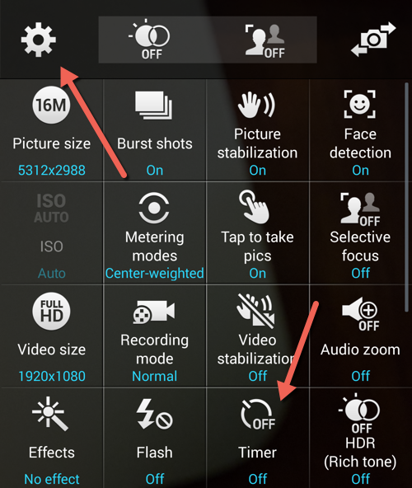
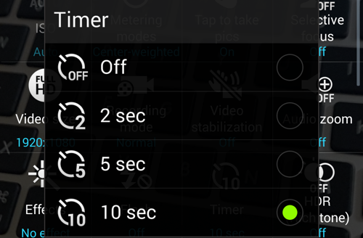
Timer
Look for the self-timer option from the menu.
The self-timer option icon looks like a clock.
Set the time delay.
Tapping on the self-timer icon will set the auto-timer, which in turn can be set for a 3- or 10-second time delay.
Once it’s set, you will be automatically back at the main view of the camera app.
Focus on the subject you mean to capture and click on the Capture button on the camera app.
Once you click on the Capture button, the timer will do a countdown, which you will be able to see on your device’s screen.
Once the countdown is up, your camera will take a picture, which will then be automatically saved in your device’s gallery.
This is a great feature that can help you take amazing photos where there is no one around to take it of you.
Just set it, press the shutter button and run into place.
If you have a tripod, great, if not find a place to set your phone down and take a picture from far away of you and the view.
A timer is also handy for snapping pics in low light when even the slightest tap to take the photo can bump the camera and blur the image.

Slide 25
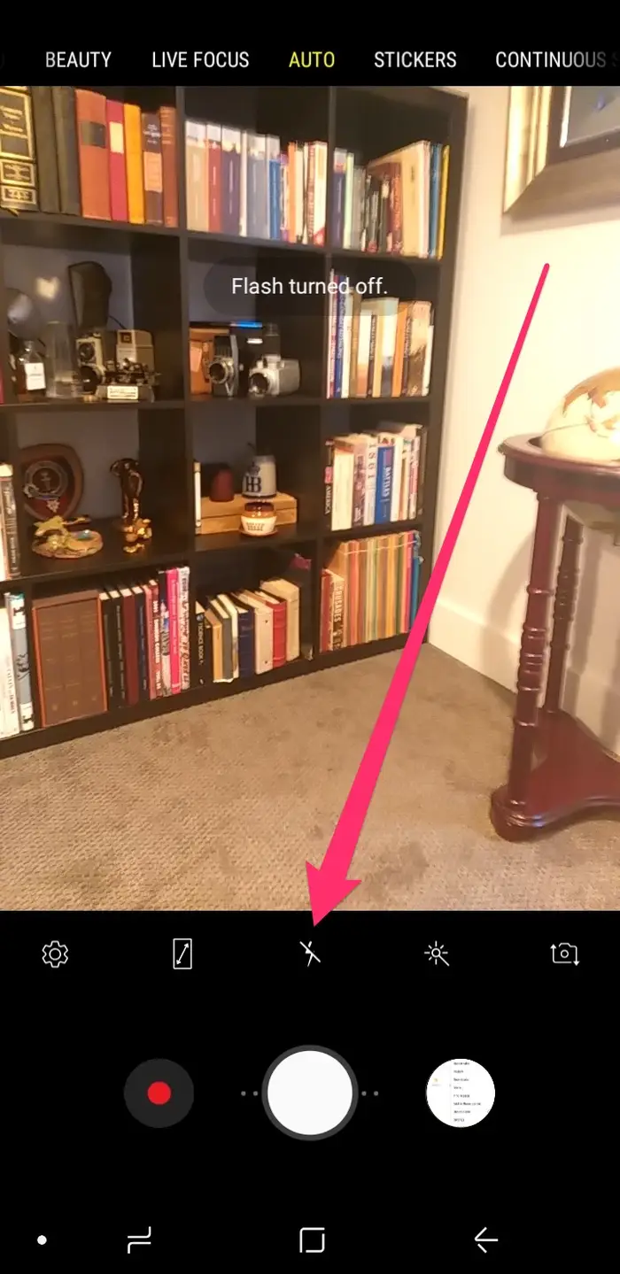
Flash On/Off
In most cases, you’ll get better results by using natural light rather than resorting to the phone’s harsh built-in flash, so make sure you know how to turn the flash off.
Open the Camera app on your Android device.
Tap on the lightning bolt icon at the bottom-center of your screen.
Tap until the lightning bolt has a slash mark through it, indicating that it's shut off.
If you've tapped to the point that the lightning bolt has an "A" next to it, it's set to automatic mode.

Slide 26
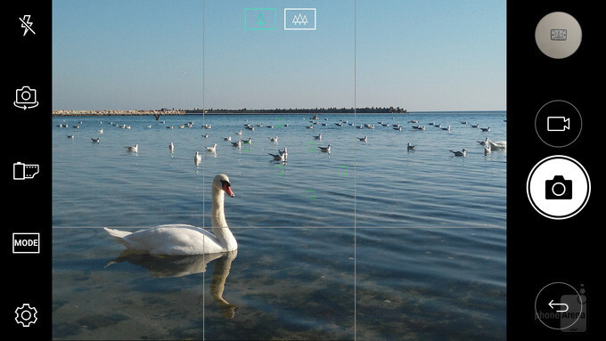
Add Gridlines
Go into the settings for your camera and turn on the gridlines.
With a grid overlaid on your camera, it will be easier to use the rule of thirds to compose your photos and get the horizon line level.
Tap on Camera icon from the Home screen.
Tap on Settings.
Select and tap on Grid lines switch to activate it.
Tap on Back to return to the camera screen.
Grid lines will be shown in the camera interface.
Move the device so that the object that needs to be photographed is placed in gridlines place.
Tap on Camera icon.

Slide 27
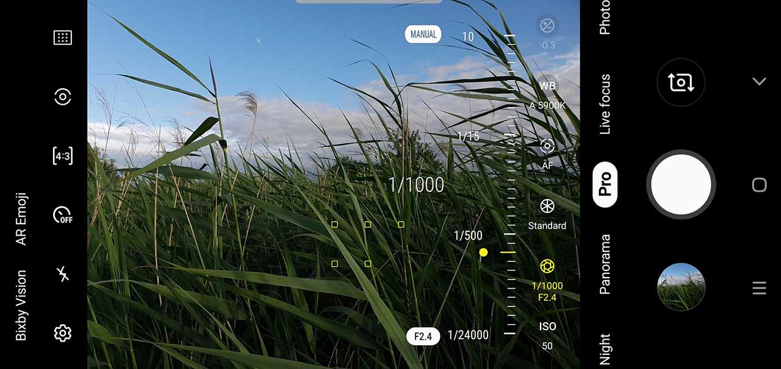
Shutter Speed Adjustment
One of the fundamentals of photography is shutter speed – which is simply how long the camera’s shutter stays open to allow light to hit the sensor.
The slower (longer) the shutter speed, the more light will hit the sensor.
If light is good, then you’ll want to use a fast shutter speed to avoid your images becoming overexposed (too bright), but if light is low, using a slower shutter speed won’t be underexposed (too dark).
Experimenting with shutter speed is also useful for creating a number of different effects. A fast shutter speed will freeze action, such as water splashing, while slower shutter speeds will create a blurred effect, creating a milky sort of effect for water, or creating effects such as light trails.
To change the shutter speed, tap the aperture icon again and use the slider to choose a speed between 1/24000 up to 10 seconds.
If you use a slow shutter speed, you’ll want to put your phone on a small tripod to prevent camera shake from blurring the image.

Slide 28
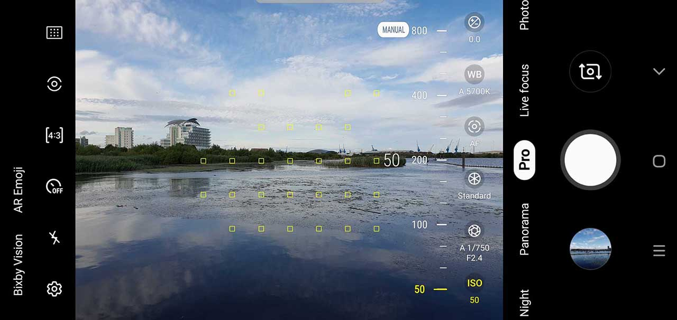
ISO Adjustment
Like shutter speed adjustment, ISO adjustment is a way you can control the final exposure of the image.
By increasing the ISO in your phone’s camera, you’re making the sensor more sensitive to light, which will allow you to take pictures in lower light.
However, keep in mind that the higher you boost the ISO the more likely it is that you’ll lose a bit of image quality; a higher ISO often results in a grainier image.
Smartphones can often be guilty of ramping up the ISO, which can lead to problems with image noise creeping into your photos.
Although most of the time, leaving this setting in Auto is absolutely fine, if you find the phone is choosing a speed which is too high for your liking, you can select a lower speed.
You’ll need to keep the phone as still as possible – if your hand isn’t that steady, try steadying yourself and the phone against something like a wall, or a table. You could even invest in a smartphone tripod to keep your phone perfectly stable.
To use this setting, tap the ISO option and drag the slider to the setting you wish to choose.

Slide 29
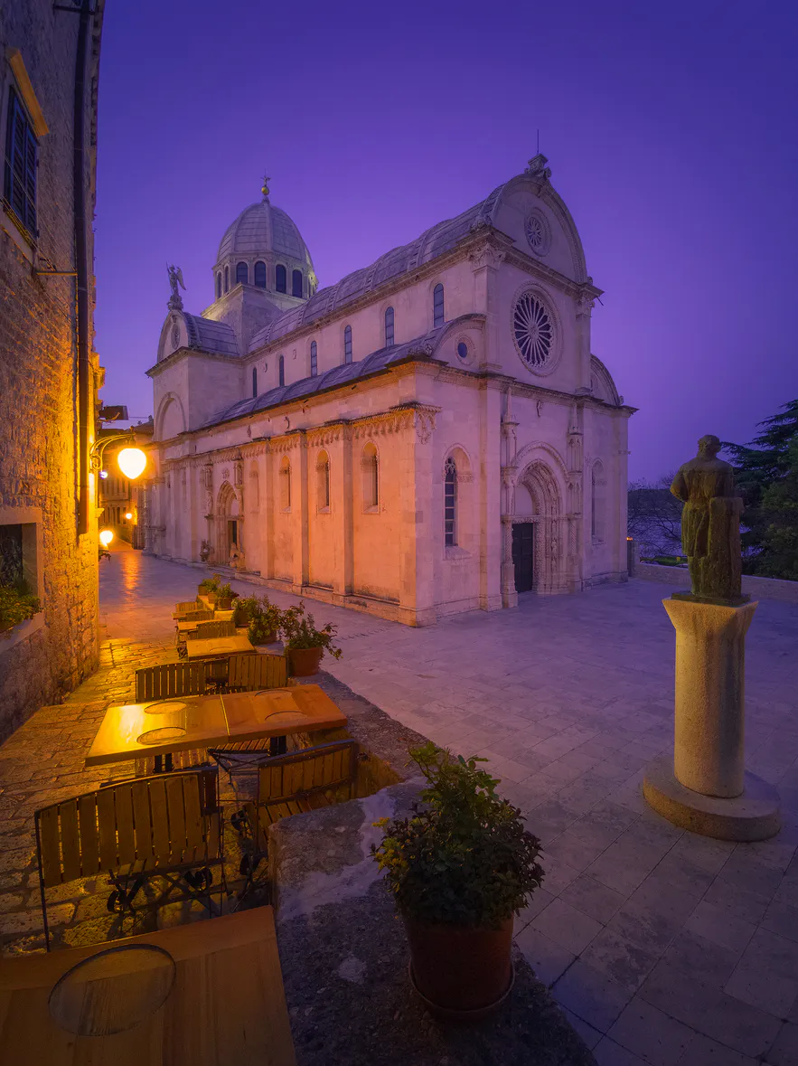
Night Mode
This mode relies heavily on using the available light to create an exposure.
As such, you may need to hold your phone very steady in order to obtain a sharp image, particularly when shooting with longer exposure times.
When using the night mode function on your mobile phone camera, it can take anywhere from 1-10 seconds to take an image.
The best part about it is that even when you’re shooting handheld, it is possible to get very sharp results without camera shake or blurriness, even when the subject is moving.
This is because when the night mode function is activated, your smartphone will take several photos in rapid succession.
It then combines the image data to achieve maximum light and color information, creating a single high-quality image that pulls data from the shadows and restores data to the highlights.
When using night mode in-field, try turning on the AI Image Stabilization setting of your smartphone camera, which will further help you to achieve sharper images.
This will reduce the need to use a tripod or to turn on the flash, meaning that you’ll end up with better landscape images with little effort.

Slide 30
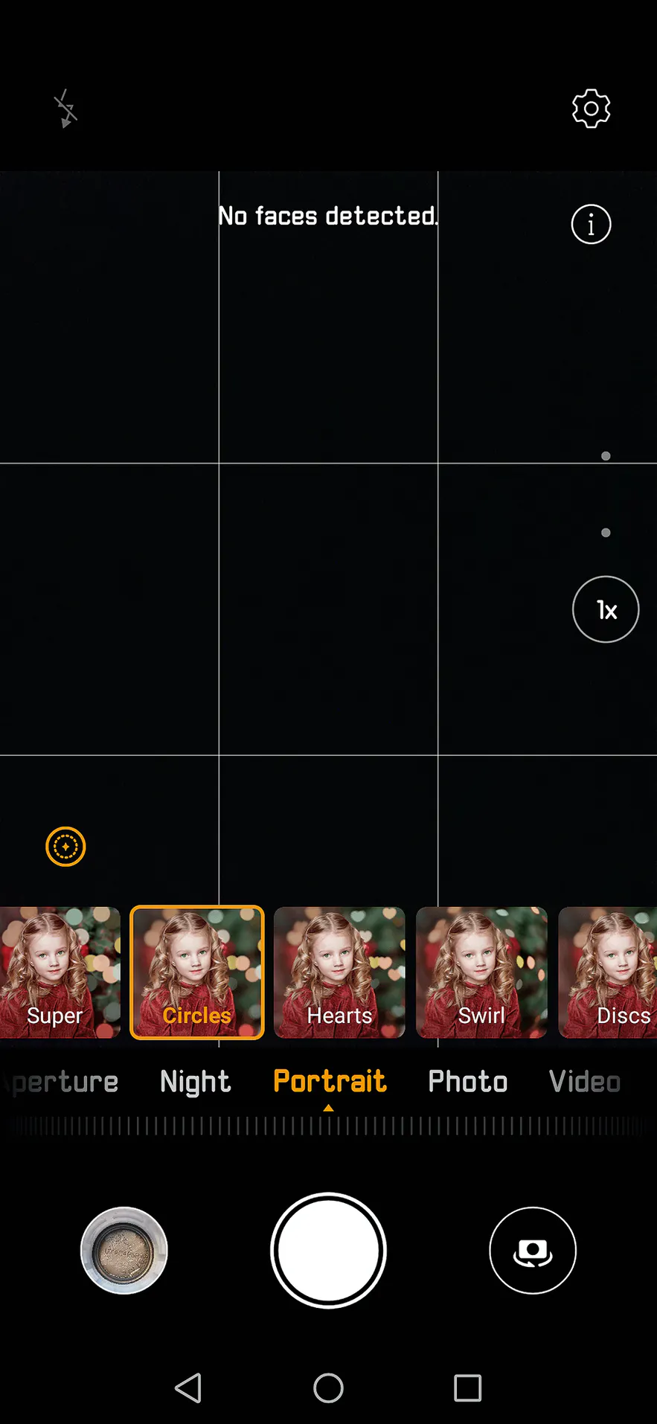
Portrait Mode
Shooting in portrait mode on a smartphone camera is very similar to aperture mode, though there are two significant advantages.
The portrait mode often comes with a range of beauty and bokeh effects, which although designed for use with faces, can also help you to get creative with your landscape photography.
Bokeh effect is the aesthetic quality of the blur produced in out-of-focus parts of an image.
For example, the beauty level can help you to smooth out a rough foreground, while the bokeh effect allows you to blur the light in the background with different shapes such as circles, hearts, swirls and discs.

Slide 31
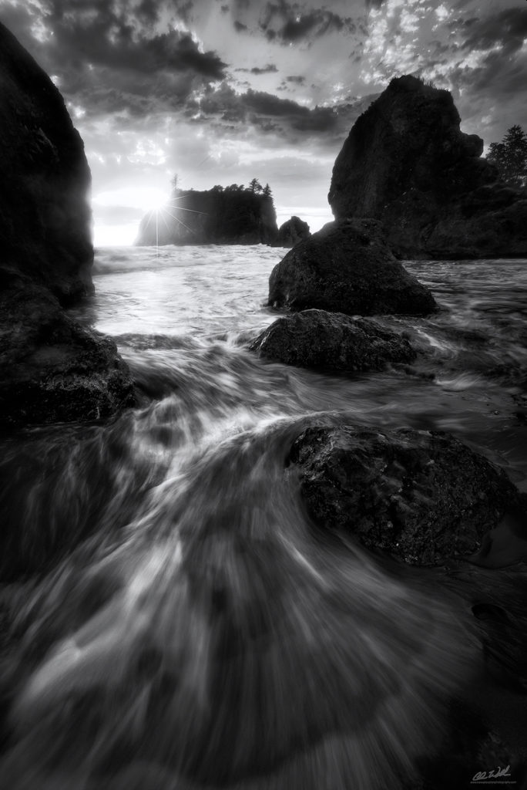
Monochrome Mode
Monochrome mode can be very useful for street and architecture photography.
However, it’s also wonderful for shooting landscapes, particularly if you want to produce something that’s a little more in the realm of fine art or if you happen to be shooting on a dark and cloudy day.
Some smartphones also have monochrome aperture, monochrome portrait and monochrome pro modes, which give you even more opportunities to explore.
Keep in mind that when you shoot in black and white, you should pay special attention to textures, patterns, lights, and shadows.
Also, you’ll have to spend a little more time editing monochrome photos in order to produce more contrast between the shades of black and white for more visual impact.

Slide 32
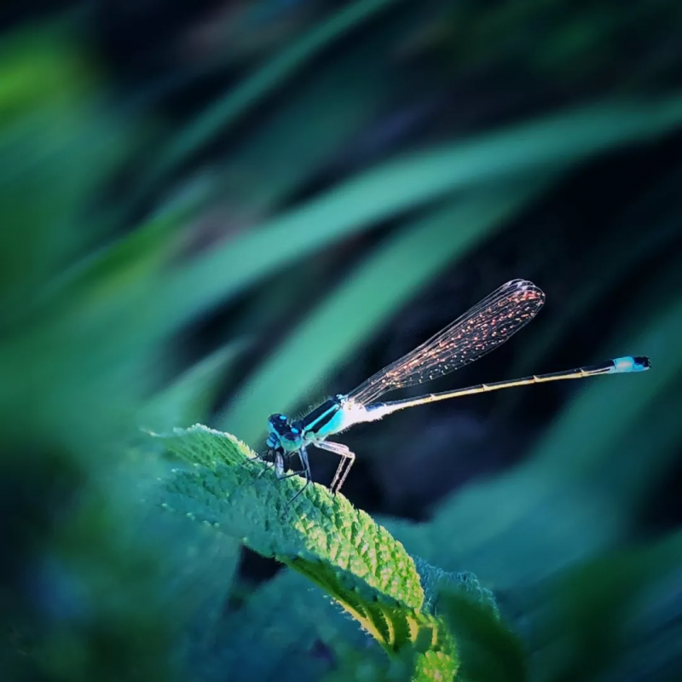
Macro or Super Macro
Super macro is a great camera mode to use when you want to shoot something that is so close to your lens that you can't get a good focus on the subject.
Most smartphone cameras tend to get a little bit blurry and have difficulty focusing at a distance of around 5-6 cm away.
The most common subjects within the landscape that you can use super macro mode with are leaves, flowers, bugs, butterflies and bees, though sometimes you can even shoot food with the super macro function for a better perspective!

Slide 33
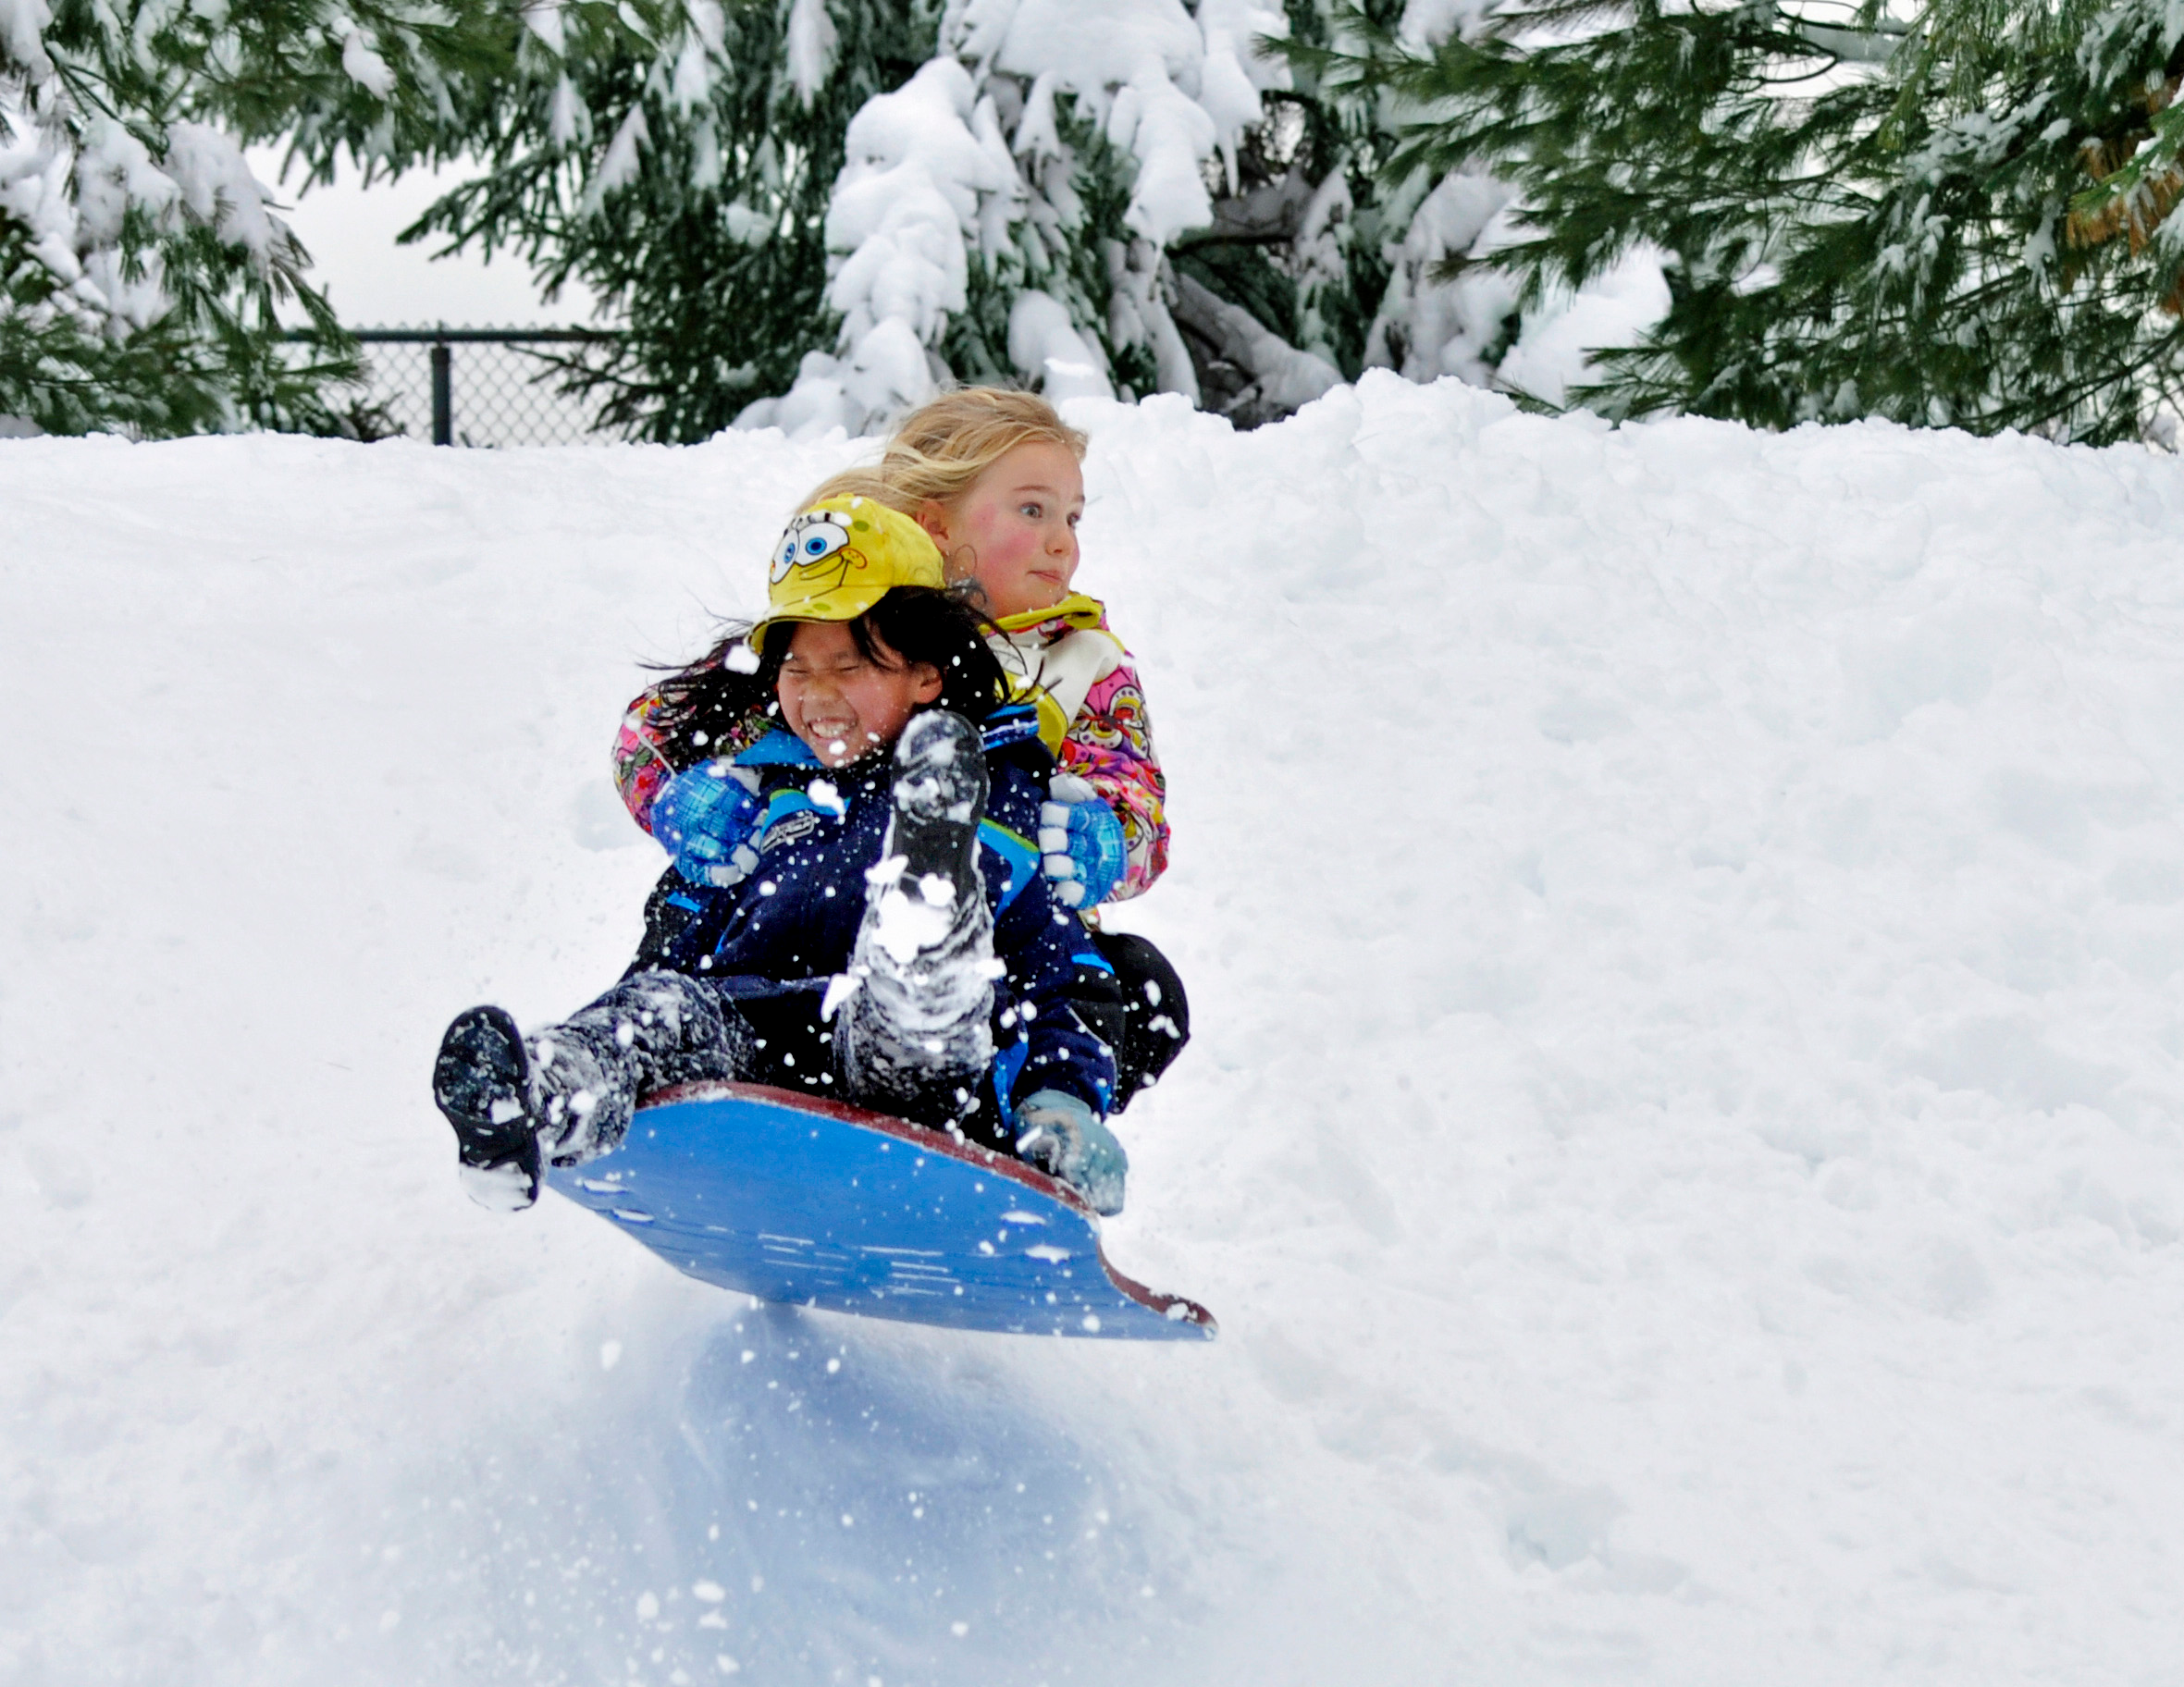
Burst Mode
You rarely get the shot you want on the first try, especially when your subject is alive and moving.
Shoot a rapid series so you can go back later and pick out the best.
Hold the shutter button to capture a burst of images.
Burst mode fires off a bunch of pictures in just a matter of seconds.
This is great for capturing quick-moving objects, like kids sledding on a bumpy hill.
Hold the shutter button to capture a burst of images

Slide 34
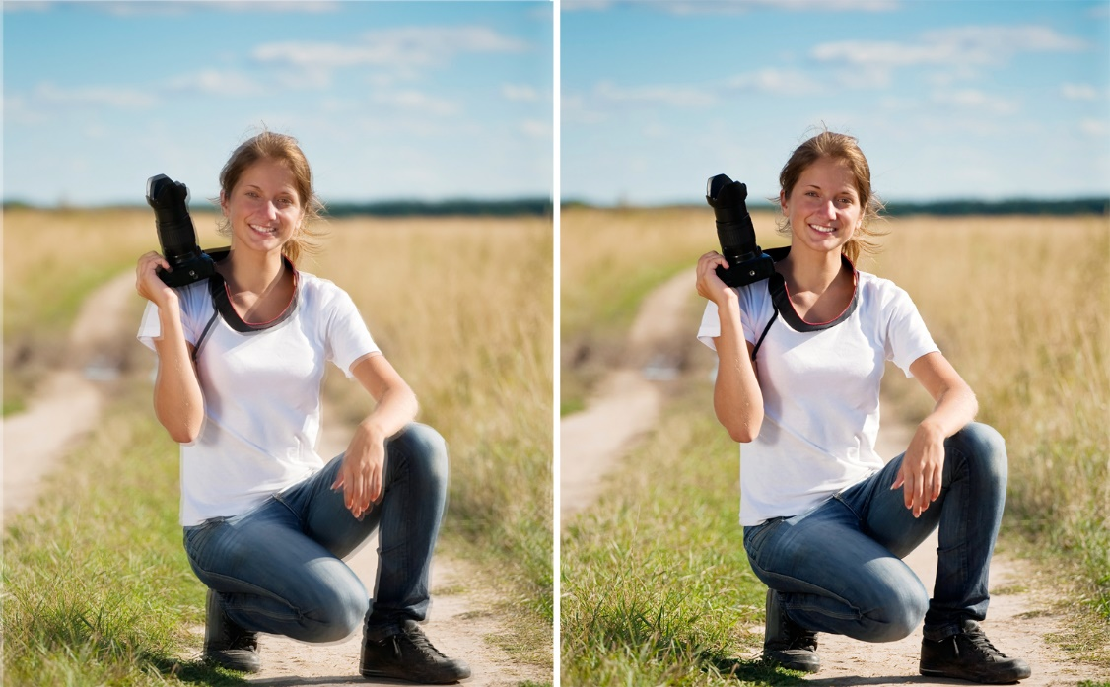
Image Stabilization
If you’re shooting in low light or an extreme close-up and struggling to get sharp images, try using an app with image stabilization.
This can help eliminate blur caused by camera shake.

Slide 35
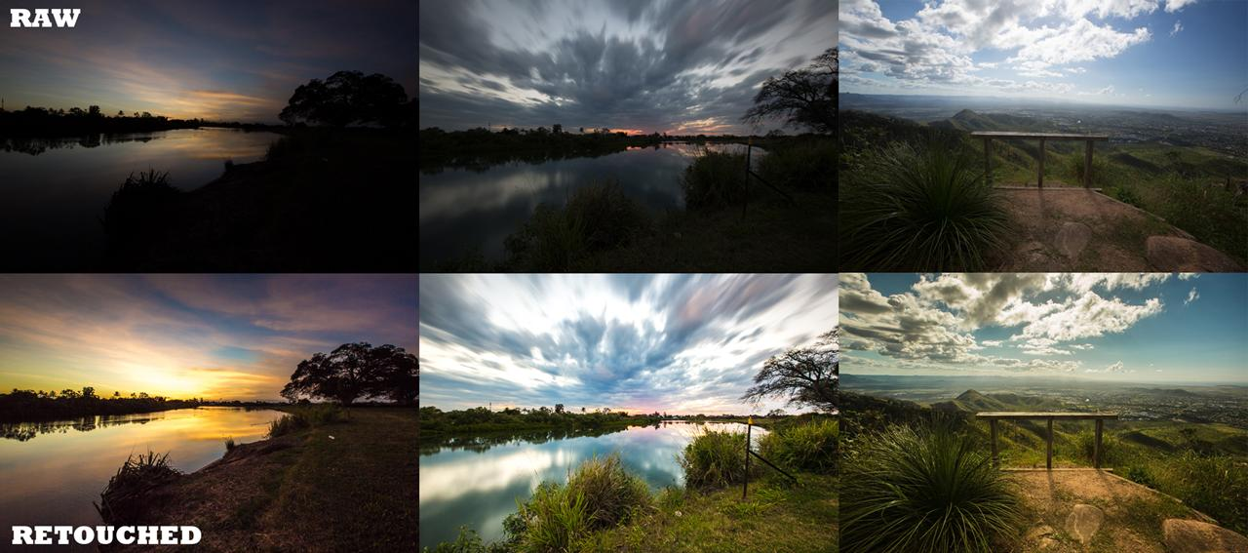
File Formats
Images are usually saved in the JPEG file format.
Some smartphones and apps will allow you to save images in different file formats, such as RAW, to preserve image quality.
RAW files can be edited a lot more than JPEGs.

Slide 36
Panoramic Mode
Sometimes, it can be difficult to fit the context of your location into one photo.
If you have not already tried panoramic mode – you will love it.
Quick tip: when you pan across – instead of tapping the screen a second time to stop the recording, simply pan back in the opposite direction!

Slide 37
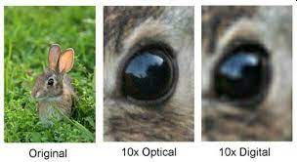
Digital Zoom
Digital zoom nearly always produces poor results as it reduces the resolution of the image.
Digital Zoom is a software effect.
The smartphone camera lens is NOT magnifying anything.
The image you see when fully zoomed out is the same as the fully “zoomed in” one.
“Zooming” in this instance is just cropping the outer parts of the same image, and increasing pixel size (or extrapolating them).
If you only have a digital zoom then instead of using it, simply move closer to maintain the image quality.
Optical zooms however are fine as they do not affect the quality of the photo and these are becoming more common on smartphones.

Slide 38
04
Use the Rule of Thirds
The most basic compositional techniques is the rule of thirds.

Slide 39
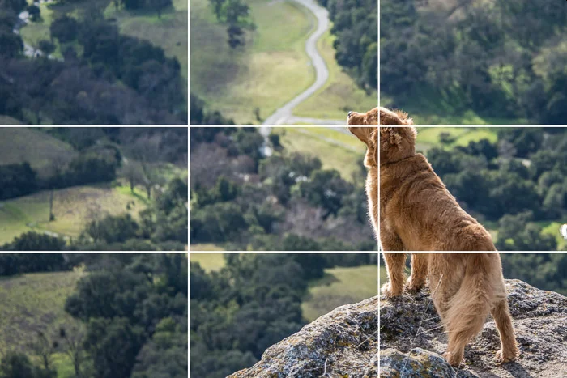
Use the Rule of Thirds
A good photo is in the composition, and one of the most basic compositional techniques is the rule of thirds.
The rule of thirds says that by breaking your image up into thirds vertically and horizontally with gridlines and positioning the subject(s) either along the lines or at the intersection of two lines, you’ll end up with a more balanced and visually interesting picture.
For example, rather than composing a photo so that your friend is smack dab in the middle, try taking the picture with them positioned off to one side.
Or, when you’re shooting a beautiful landscape, try placing the horizon at the top or bottom third of the photo rather than cutting across the middle.
Turning on the grid in your phone’s camera app is an easy way to keep the rule of thirds on the top of your mind while taking pictures.

Slide 40
05
Make Use of Leading Lines
Carefully compose lines in your pictures.

Slide 41
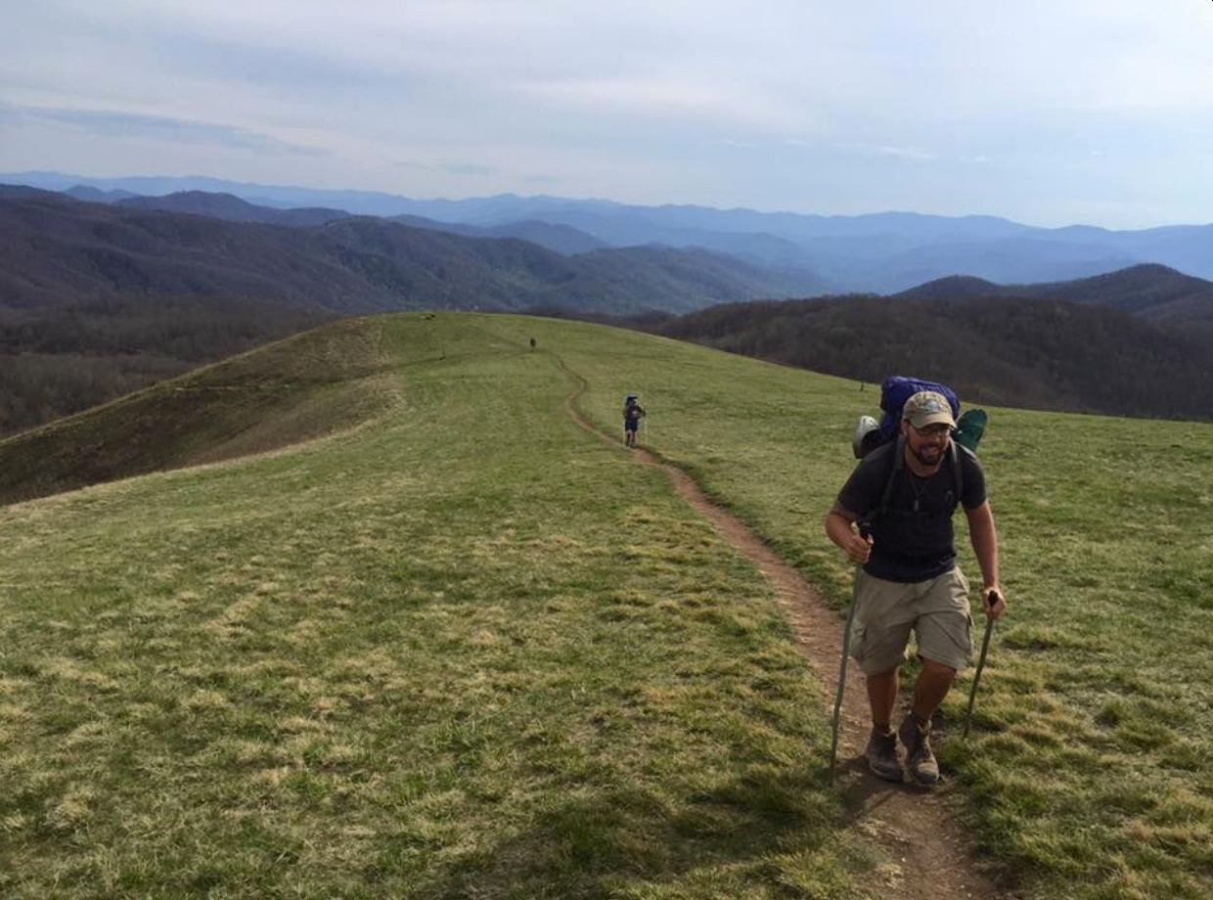
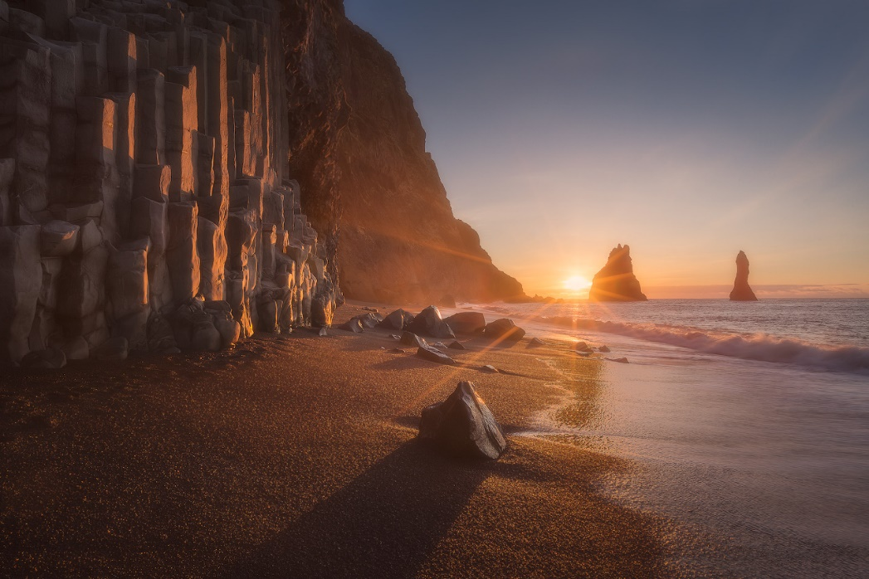
Make Use of Leading Lines
Carefully composing lines in your pictures is a powerful way of drawing the viewer’s attention to the main subject and creating a sense of movement through the image.
For instance, a picture that shows a hiking trail coming in from the bottom left of the image and going off into the distance at the upper right can guide the viewer’s eye through the image to the solo hiker at the end of the trail.
Trails naturally make good leading lines, but so do roads, rivers, shorelines, trees and cliffs.

Slide 42
06
Use the Foreground, Middle Ground and Background
Include interesting elements in the foreground, middle ground and/or background.

Slide 43
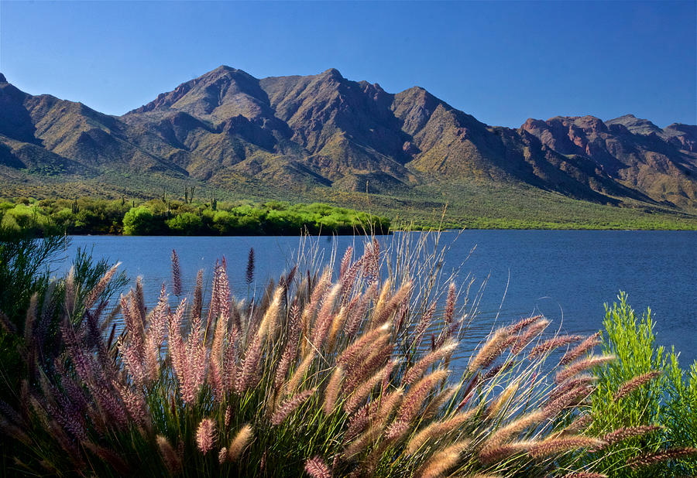
Use the Foreground, Middle Ground and Background
When composing your photos, try to include interesting elements in the foreground, middle ground and/or background.
For example, if you’re taking a picture of the mountains, rather than only including the mountains in the photo, try incorporating something interesting in the foreground and/or middle ground to draw the viewer’s eye through the image.
This could be a person, a flowering plant, some rocks or a beautiful lake.
If you want to play around with blurring the foreground, middle ground and/or background, you’ll need to see if your camera app has a mode that can do this, such as a portrait mode, since most smartphone cameras won’t let you adjust the aperture for a shallow depth of field.
You can also add blurring to photos with many editing apps (look for something called lens blur or similar).

Slide 44
07
Change Your Perspective
Change your viewpoint by taking photos from a bird’s-eye view or worm’s-eye view.

Slide 45
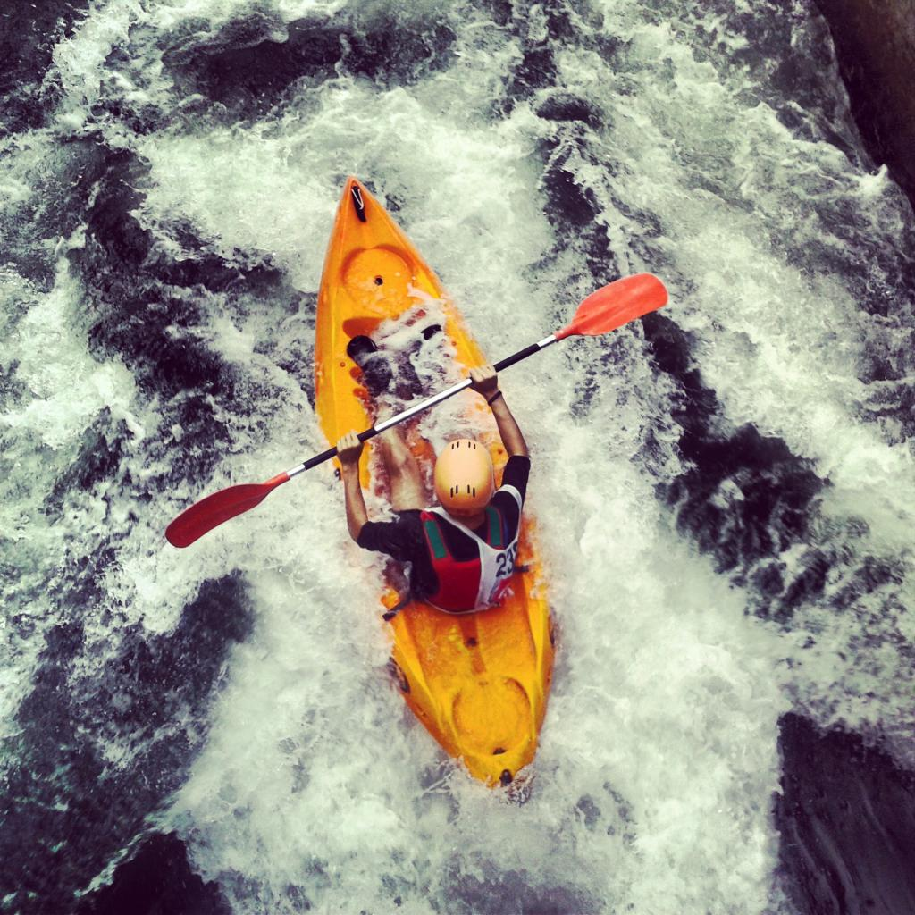
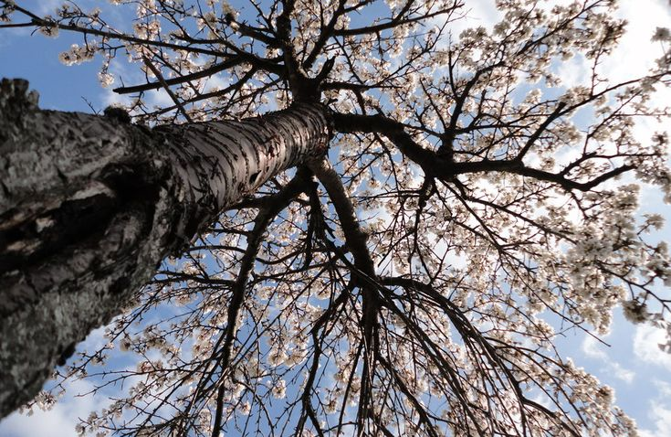
Change Your Perspective
When using a phone camera, it’s easy to get in the habit of always holding your phone in front of you with outstretched arms and snapping photos from head height.
But phones are so small and light that you can easily mix things up and shoot from just about any perspective.
Try changing your viewpoint by taking photos from a bird’s-eye view or worm’s-eye view.

Slide 46
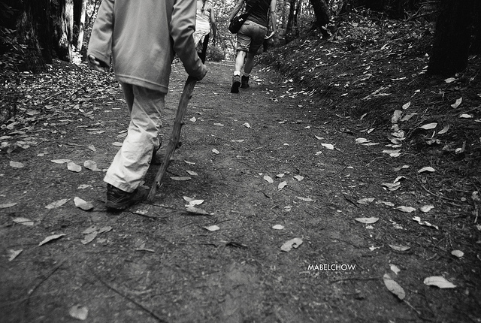
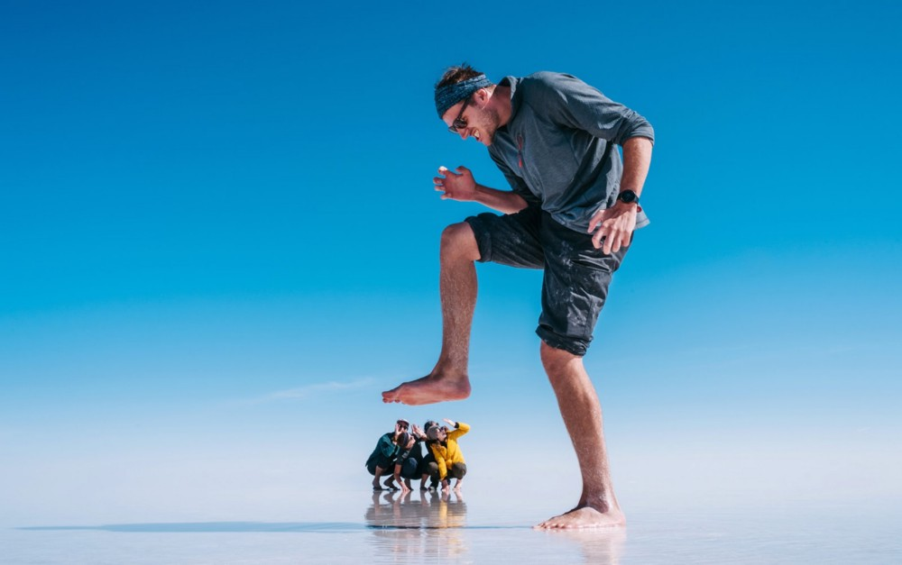
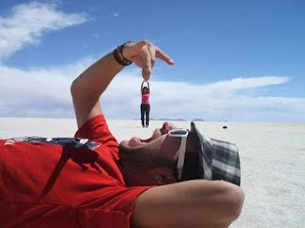
Change Your Perspective
You can shoot from the hip…
…or use a forced perspective.

Slide 47
08
Play with Distance
To showcase a spectacular background.

Slide 48
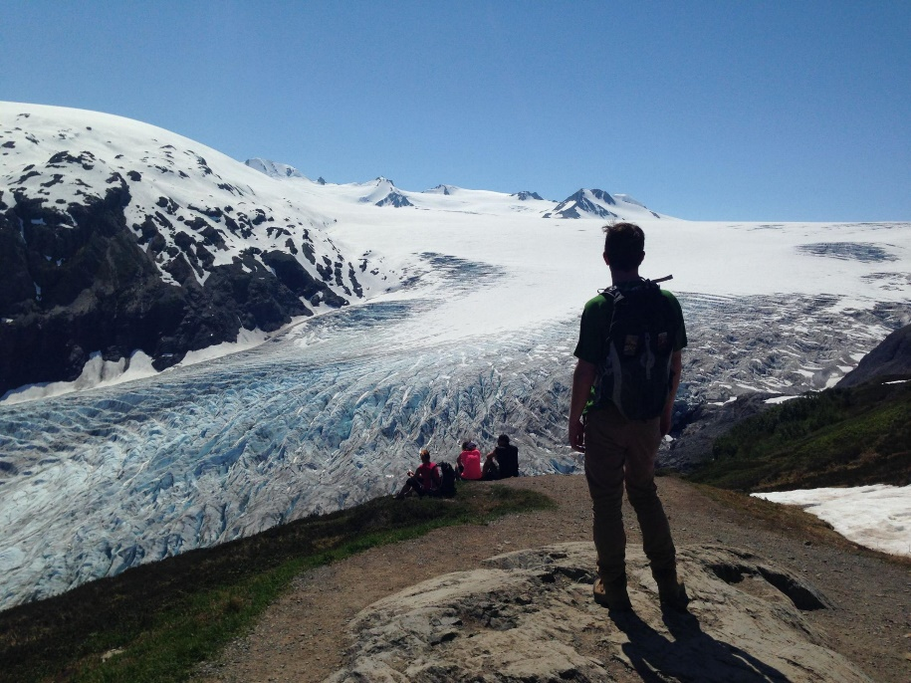
Play with Distance
When stuck with a boring, poorly lit, or overly distracting background, get close and let your subject dominate the frame.
Note: This advice does not apply when your subject is a wild animal. Always keep a safe distance from wildlife.
For dynamic action shots, back up to a medium distance, just enough to get your subject’s full height into the frame.
To showcase a spectacular background, try backing up even more and using a person, animal, or object in the middle distance to create a sense of grand scale.

Slide 49
09
Shoot when the Light is Right
Your best, most effortless captures will happen in the “golden hours” just after dawn and just before dusk.

Slide 50
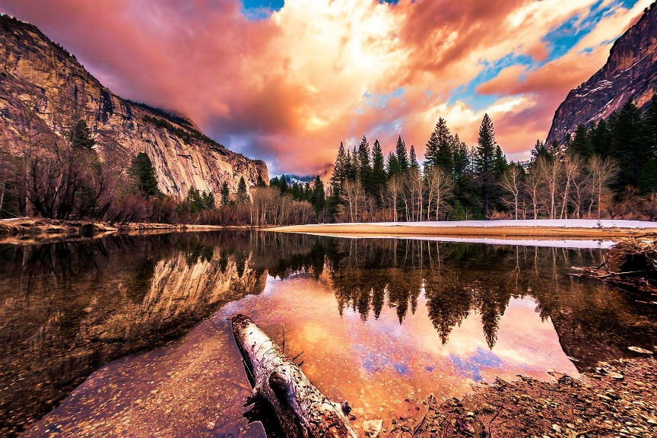
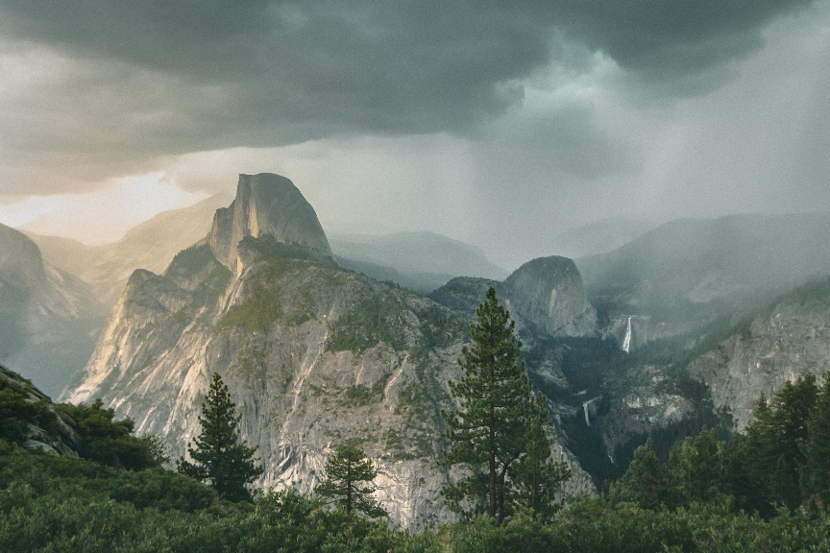
Shoot when the Light is Right
Your best, most effortless captures will happen in the “golden hours” just after dawn and just before dusk, when the low-angled sun bathes everything in gentle, golden hues. Determine when the golden hours are each day, as they vary by season and latitude.
Overcast days are nice, as cloud cover dampens the sun’s rays, providing soft, even lighting.
Just after a light rain is a good time to shoot landscapes for extra bold colors and stirring close-ups of droplets on petals.
Always take advantage of natural light. If you have control over your subject, set them up in a gently sunlit spot.
Use ﬂash as a last resort. Exception: if you’re shooting into the sun with your subject in the foreground, try using ﬂash to illuminate your subject and prevent silhouetting.

Slide 51
10
Add Motion
Try playing around with time-lapse, slo-mo and video.

Slide 52
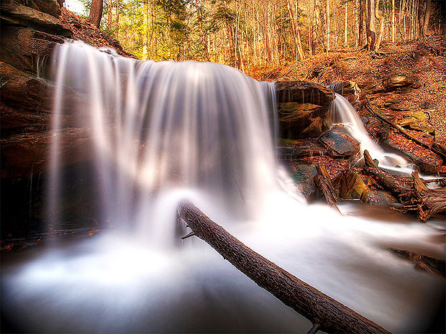
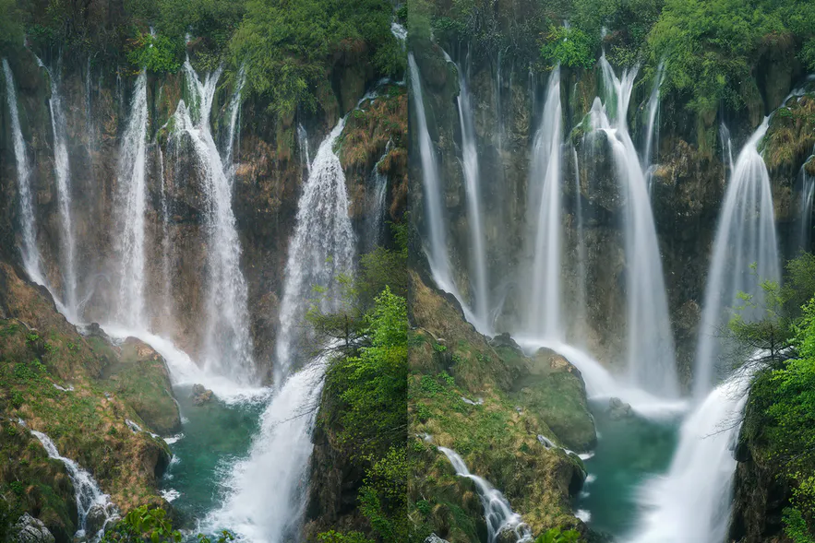
Add Motion
If you’re struggling to capture the grandeur of the scene around you with a still photo, try playing around with time-lapse, slo-mo, and video.
These come standard on most phone camera apps and can be a fun and beautiful way to capture things like moving water, the setting sun or your friend goofing around on the trail.
Normal vs. time lapse effect with a smartphone.

Slide 53
11
Add Camera Accessories
There are add-ons for phone cameras that can help
you.

Slide 54
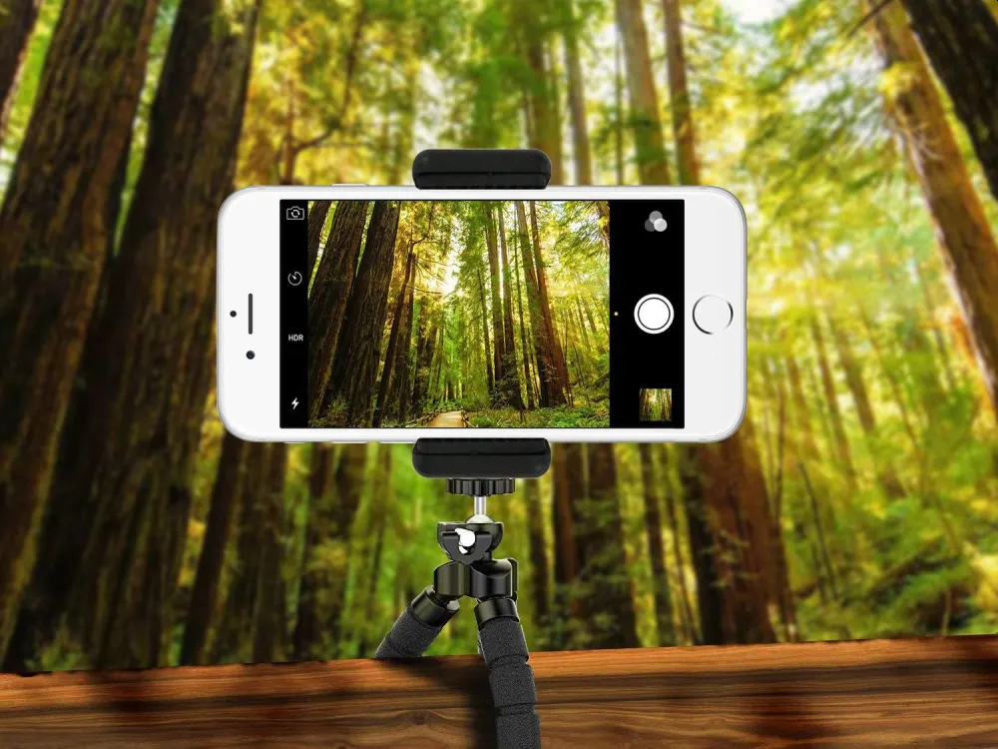
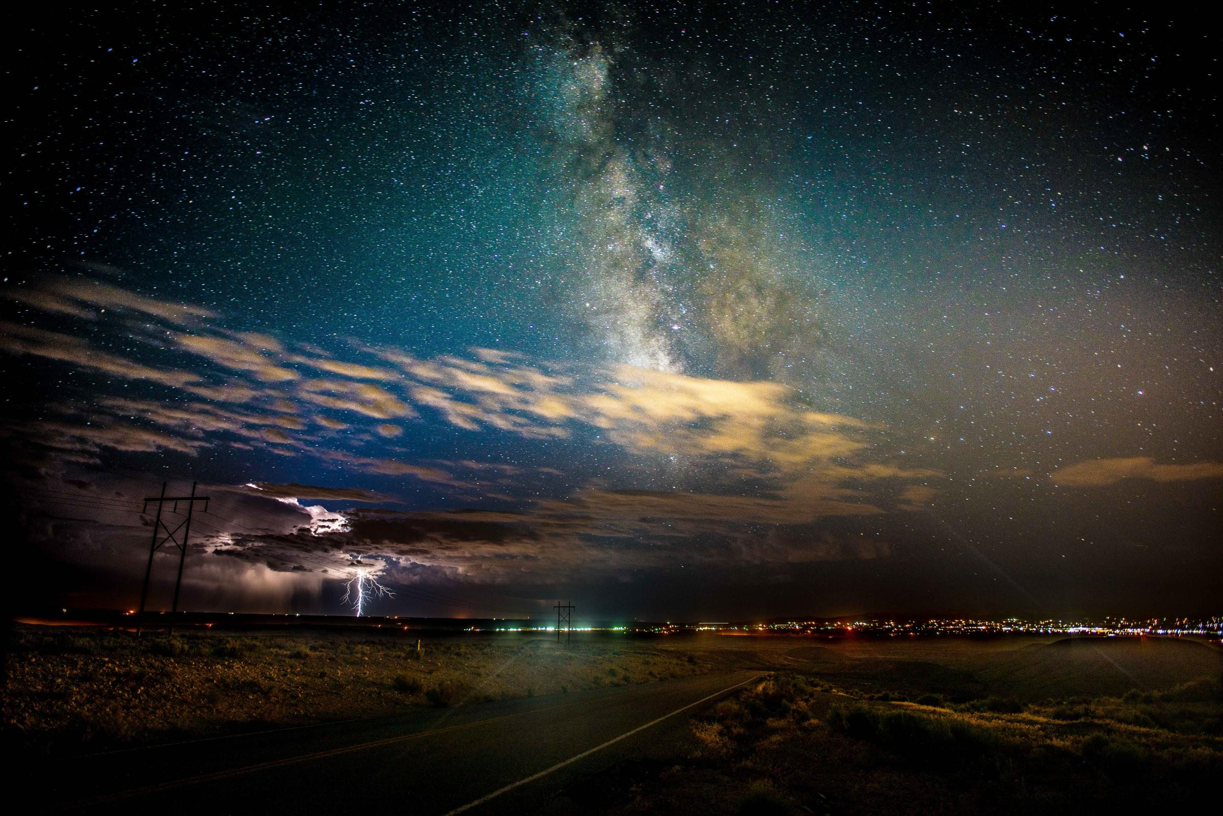
Add Camera Accessories
There are quite a few add-ons for phone cameras that can help you achieve a certain creative element that you’re trying to capture.
If you want to take longer exposures of a night sky to show the stars or a beautiful stream in order to blur the movement of water, you’ll need a mini tripod to stabilize your camera.

Slide 55
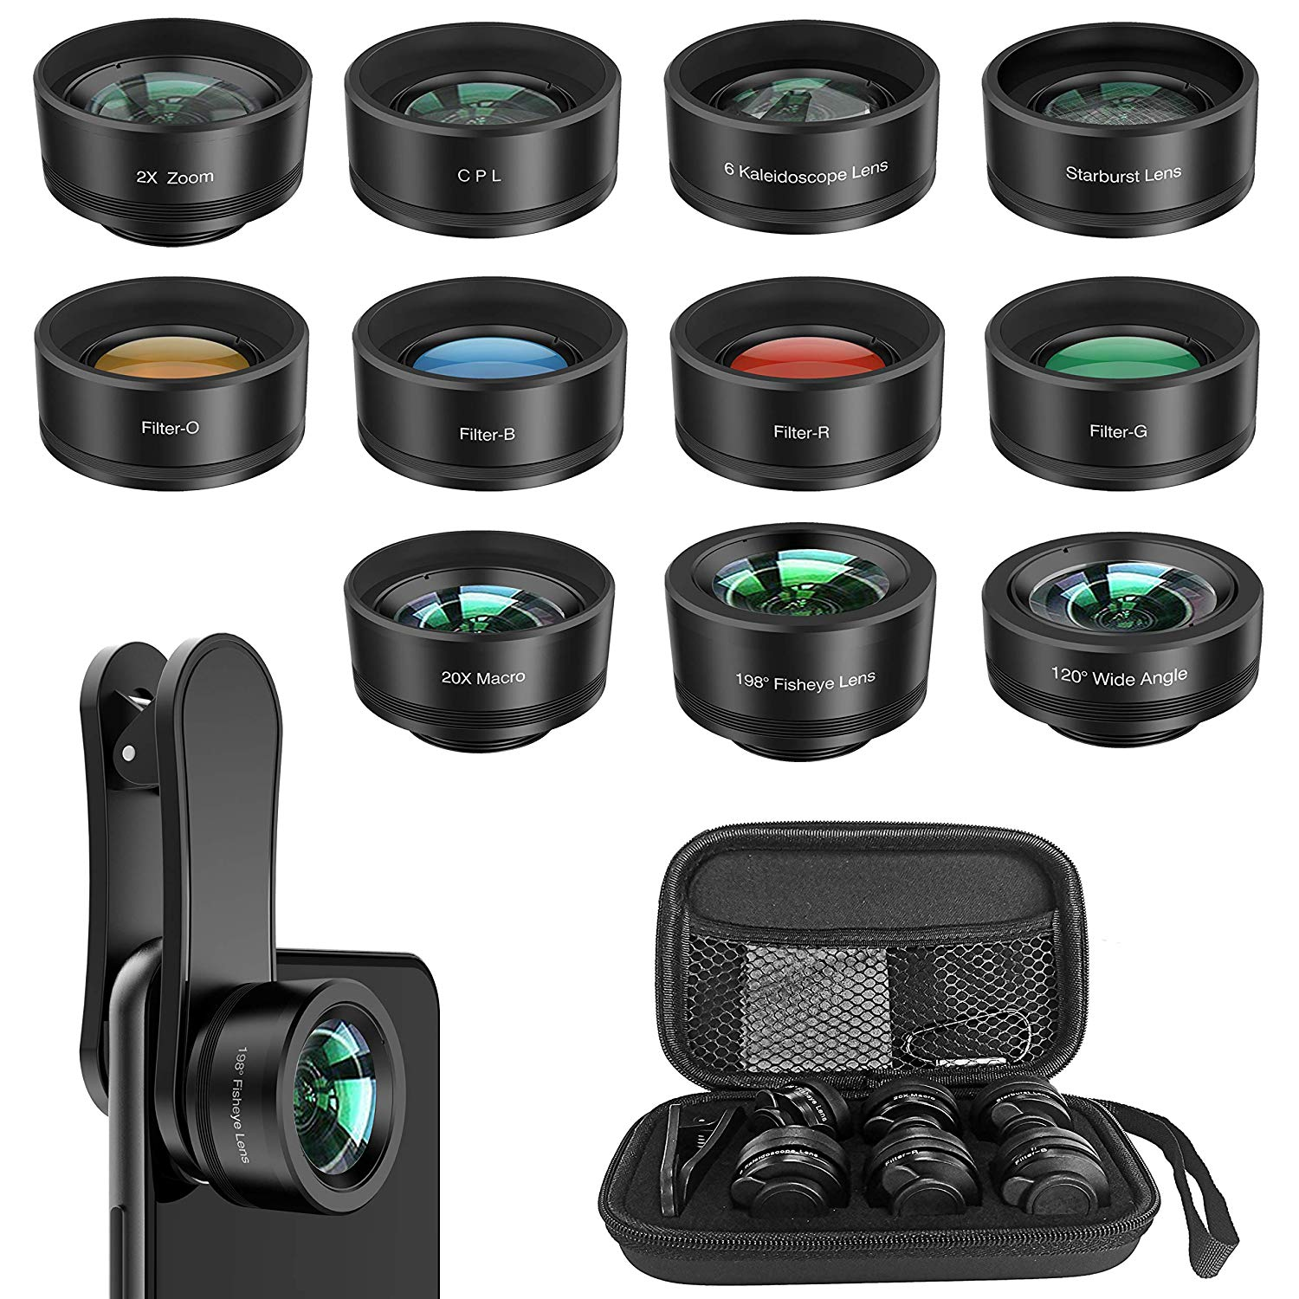
Add Camera Accessories
Most phones these days are capable of taking beautiful photos.
However, another option is to add lenses to your phone so you can take fish- eye, macro and wide-angle photos.
External, universal lenses allow you to achieve unique perspectives.
Yoidesu 11-in-1 Phone Lens Kit
This clip-on kit includes 11 different lenses and filters. Included are four standard lenses: a 0.36x Wide Angle lens, a 198-degree Fisheye lens, a 20x Macro lens, a 2X telephoto lens. You also get a collection of filters that include four color filters (orange, red, green, and blue), a CPL filter that reduces glare off of reflective surfaces, a Starburst filter that makes lights twinkle, and a Kaleidoscope lens just for fun. All that packaged with a convenient and (essential) travel case. $40 on Amazon.

Slide 56
12
Take a Portable Battery Pack
Don’t run out of power.

Slide 57
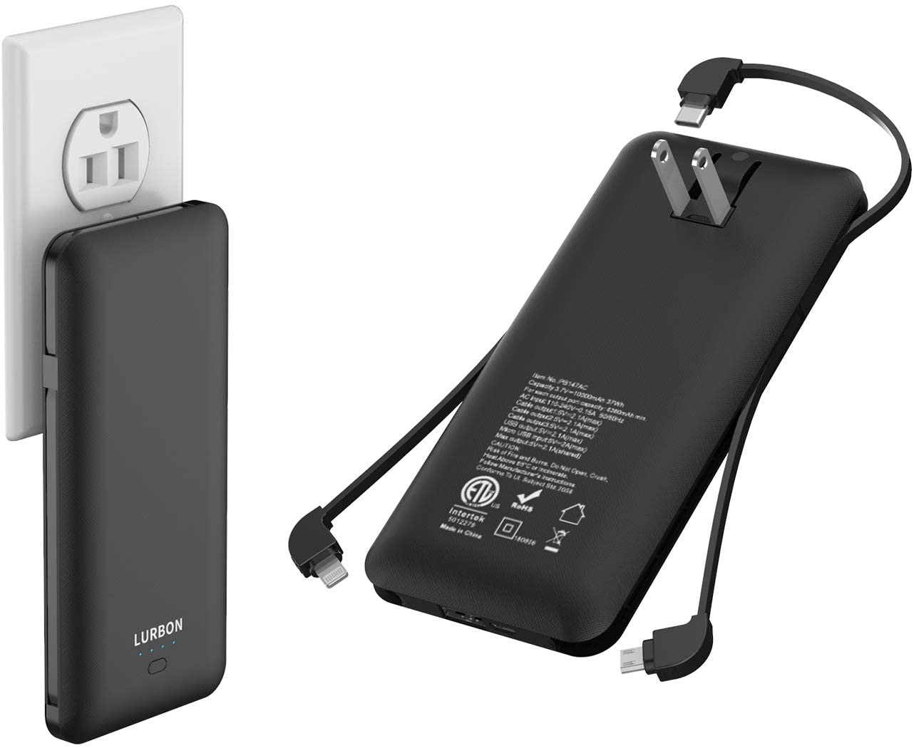
Take a Portable Battery Pack
These handy devices will remove the anxiety of running out of battery while on an adventure outing.
Simply attach the USB end of your charging cable to the device to recharge your smartphone.
Some come with compatible cables attached.
If you forget the cable – then you can put your smartphone on airplane mode to conserve battery.

Slide 58
13
Edit Your Photos
Photo editing can go a long way toward improving your photos.

Slide 59
Edit Your Photos
A little photo editing can go a long way toward improving your photos.
Most default camera apps that come on smartphones allow some level of editing, but by downloading a third-party app like Snapseed (iPhone or Android), Adobe Lightroom CC (iPhone or Android), or VSCO Cam (iPhone or Android) you get a lot more control.
Apps like these allow you to adjust brightness, tweak contrast, boost saturation, apply filters, sharpen fuzzy images and a whole lot more.
Most of them also have auto adjustments that make it really quick and easy to edit photos.

Slide 60
Adventure photography is probably the only field of photography that is exclusively shot by participants. Being a participant in the adventure gives you a front row seat to the action.
Terry McKibben
Assistant Scoutmaster Troop 344/9344
Pemberville, OH
troop344leaders@gmail.com

